Slide 1
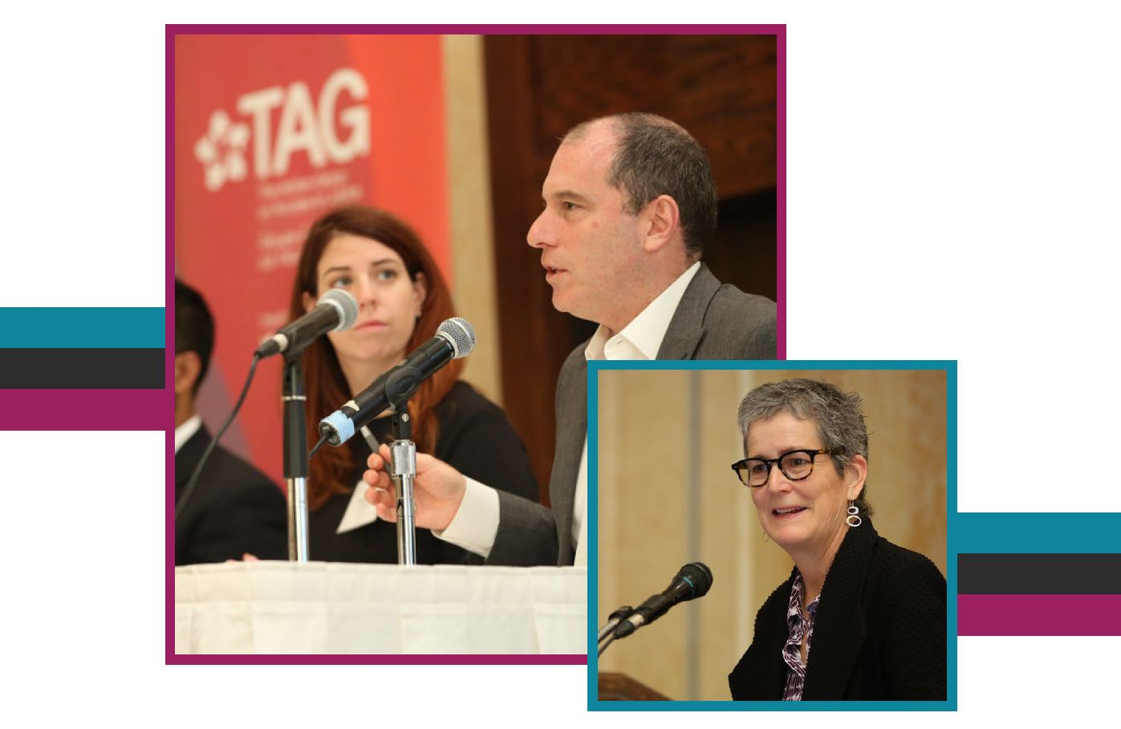
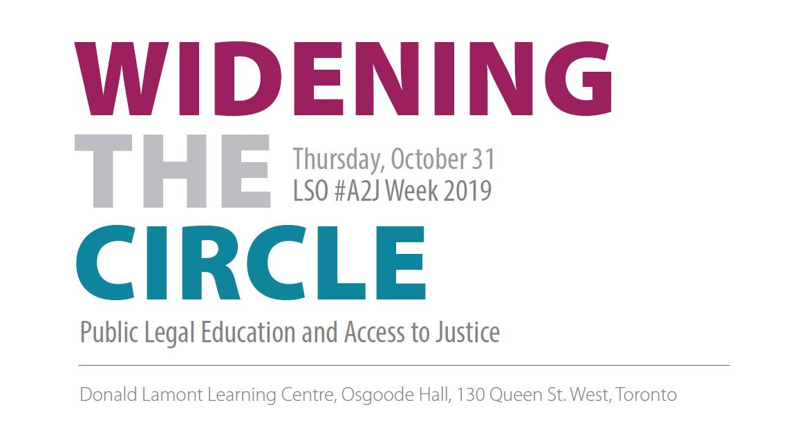


Slide 2
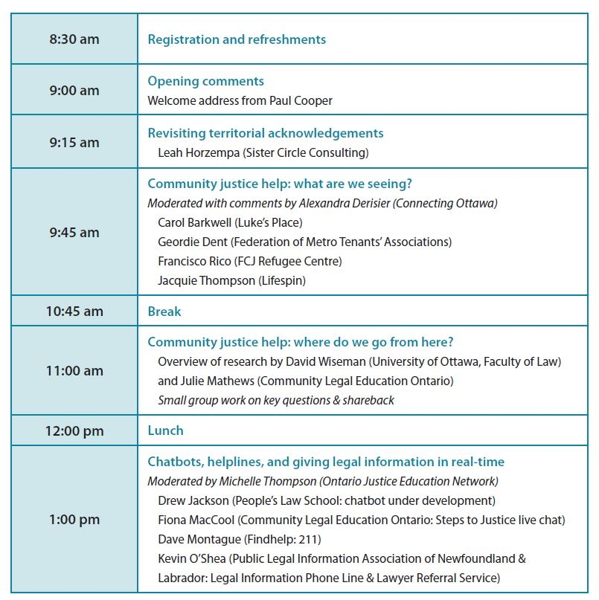
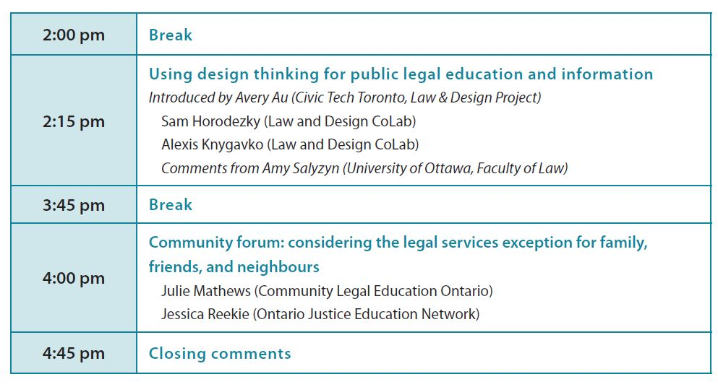
SCHEDULE

Slide 3
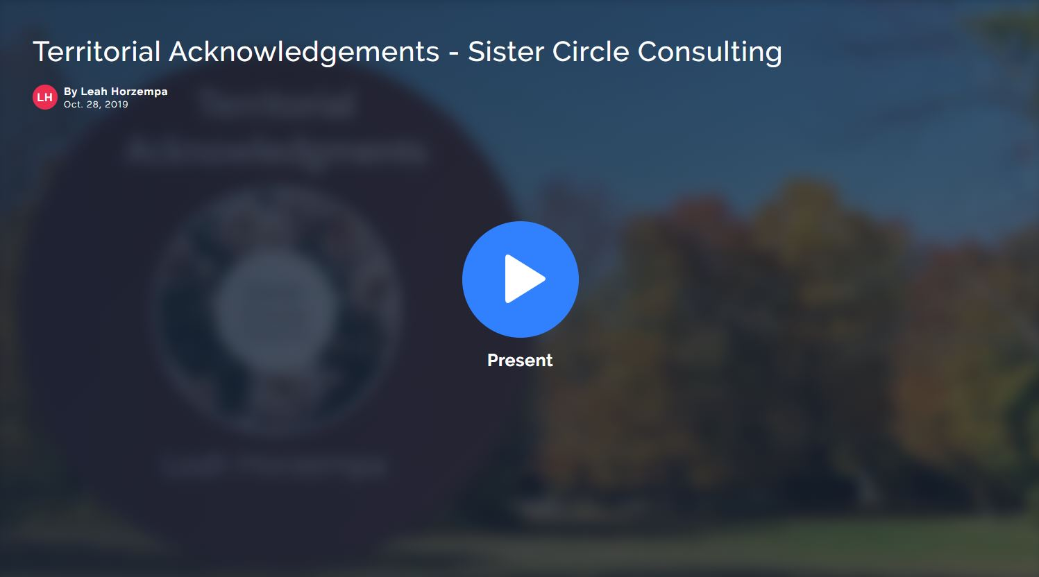
Revisiting Territorial Acknowledgements

Slide 4
Community Justice Help: What are we seeing?
Alex Derisier, Connecting Ottawa
Carol Barkwell, Luke’s Place
Geordie Dent, Federation of Metro Tenants’ Associations
Francisco Rico, FCJ Refugee House
Jacquie Thompson, Life*Spin

Slide 5
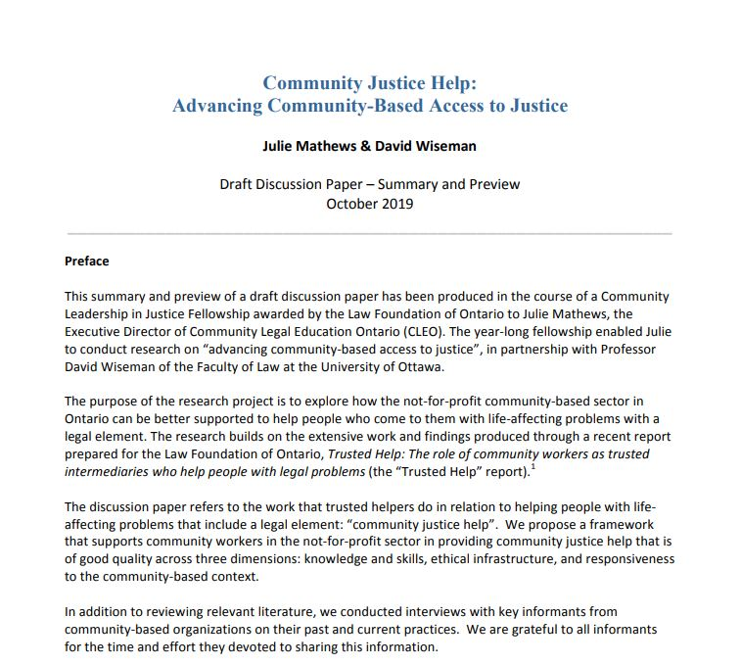

Community Justice Help: Where do we go from here?
David Wiseman, University of Ottawa
Julie Mathews, Community Legal Education Ontario

Slide 6
Chatbots, helplines, and giving legal information in real-time
Michelle Thompson, Ontario Justice Education Network
Fiona MacCool, Community Legal Education Ontario (Steps to Justice live chat)
Drew Jackson, People’s Law School (chatbot under development)
Kevin O’Shea, Public Legal Information Association of Newfoundland & Labrador (Legal Information Phone Line & Lawyer Referral Service)
Dave Montague, Findhelp (211)

Slide 7
The Steps to Justice Live Chat Experience Panel Discussion on chat bots, hotlines, and giving real-time legal information
Access to Justice Event: October 31, 2019
Presented by Fiona MacCool, CLEO

Slide 8
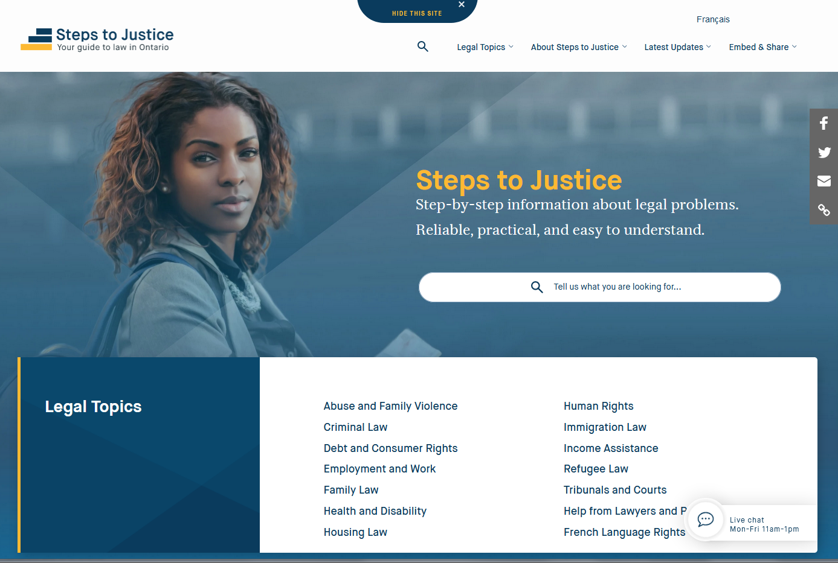
Steps to Justice

Slide 9
How Steps to Justice works
Gives step-by-step information on common legal questions
Links to forms, checklists, self-help guides
Integrates referral information
We have over 1,000 detailed Questions and Answers/Next Steps on the site in English and French
The content covers 14 areas of law
Notes:
As we mentioned above, it is for people with legal problems who have access to the Internet and who and are able to and comfortable in looking for information online
Information on common legal questions across 13 legal topics: housing, family, employment, debt and consumer rights, income assistance, criminal – some human rights, immigration
Each area of law is broken down into sub-topics with a list of questions
Where there are long lists of questions, you can filter them by topic
The answers don’t just speak to legal topics in generalized terms – they respond to specific commonly asked questions and provide practical steps that people can take to address their legal problems – or to avoid a legal problem
We know that different people are comfortable taking different steps, depending on their circumstances – designed to be flexible for different needs and capabilities of users
Our information has Direct Links:
Brings in information and content produced by others, including other clinics and various resources produced by government, LAO, courts and tribunals, and other organizations including CLEO – builds on legal information that’s already out there – not reinventing the wheel and wasting resources
Links to forms, checklists, self-help guides, services, other resources – so you do not have to leave the site to find these things when brought up in context
In terms of referrals, each question has a “Find services” section where we offer referrals to services across Ontario that people can go to for in person help – legal clinics, social and community services – example: centres for abused women and children
We also have the 211 site embedded on the Find Services page so you can find local referrals for wherever you are in the province
Page views in its first year -- about 700 k
Page views in 2018 – about 3.3 million
-also offers a Live Chat feature, which we’ll talk about in a couple of minutes

Slide 10
How Live Chat Works
We offer daily live chat assistance to users from 11:00 a.m. – 1:00 p.m.
Because of increased demand, we have two operators on staff each day
We provide links to information on Steps to Justice and referral information where possible
We use Zendesk as the live chat tool, recently changing from SLAASK
Notes:
As we mentioned above, it is for people with legal problems who have access to the Internet and who and are able to and comfortable in looking for information online
Information on common legal questions across 13 legal topics: housing, family, employment, debt and consumer rights, income assistance, criminal – some human rights, immigration
Each area of law is broken down into sub-topics with a list of questions
Where there are long lists of questions, you can filter them by topic
The answers don’t just speak to legal topics in generalized terms – they respond to specific commonly asked questions and provide practical steps that people can take to address their legal problems – or to avoid a legal problem
We know that different people are comfortable taking different steps, depending on their circumstances – designed to be flexible for different needs and capabilities of users
Our information has Direct Links:
Brings in information and content produced by others, including other clinics and various resources produced by government, LAO, courts and tribunals, and other organizations including CLEO – builds on legal information that’s already out there – not reinventing the wheel and wasting resources
Links to forms, checklists, self-help guides, services, other resources – so you do not have to leave the site to find these things when brought up in context
In terms of referrals, each question has a “Find services” section where we offer referrals to services across Ontario that people can go to for in person help – legal clinics, social and community services – example: centres for abused women and children
We also have the 211 site embedded on the Find Services page so you can find local referrals for wherever you are in the province
Page views in its first year -- about 700 k
Page views in 2018 – about 3.3 million
-also offers a Live Chat feature, which we’ll talk about in a couple of minutes

Slide 11
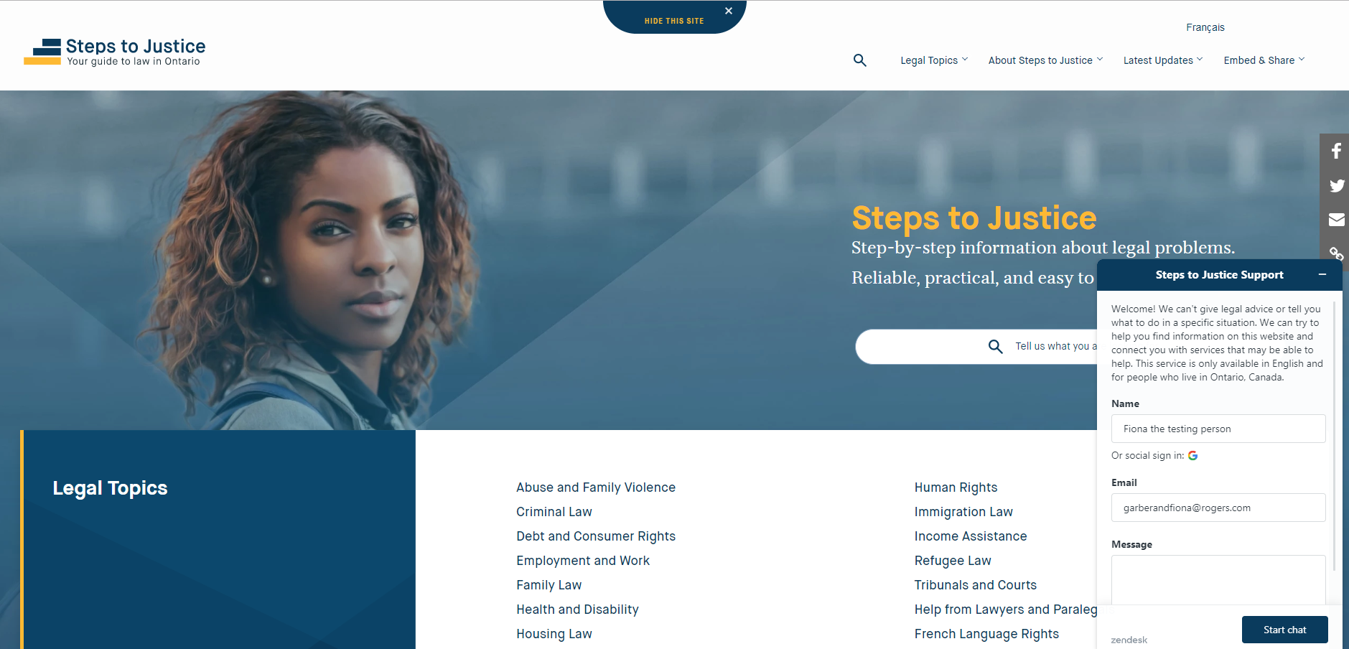

Slide 12
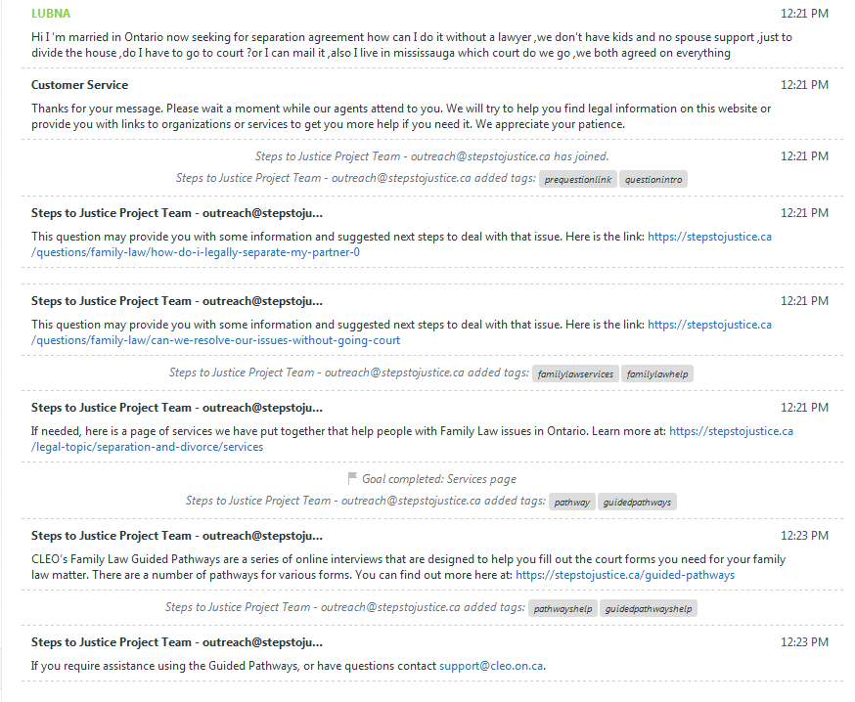
Steps to Justice Live Chat – Sample Transcript

Slide 13
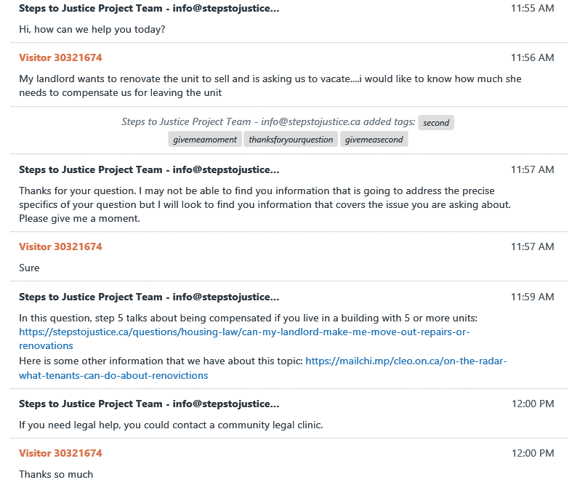
Steps to Justice Live Chat – Sample Transcript

Slide 14
Live Chat by the Numbers – Sept 2019
September, 2019 | Steps to Justice Website Sessions or Visitors | Steps to Justice Live Chats Served
Sessions | 358,961 | 1036
Most asked about Legal Topics
September | Chats Served | Family Law | Housing | Employment | Getting Legal Help | Tribunals and Courts | Criminal | Abuse | Consumer
Totals: | 1020 | 305 | 170 | 175 | 179 | 97 | 96 | 30 | 27
Notes:
As we mentioned above, it is for people with legal problems who have access to the Internet and who and are able to and comfortable in looking for information online
Information on common legal questions across 13 legal topics: housing, family, employment, debt and consumer rights, income assistance, criminal – some human rights, immigration
Each area of law is broken down into sub-topics with a list of questions
Where there are long lists of questions, you can filter them by topic
The answers don’t just speak to legal topics in generalized terms – they respond to specific commonly asked questions and provide practical steps that people can take to address their legal problems – or to avoid a legal problem
We know that different people are comfortable taking different steps, depending on their circumstances – designed to be flexible for different needs and capabilities of users
Our information has Direct Links:
Brings in information and content produced by others, including other clinics and various resources produced by government, LAO, courts and tribunals, and other organizations including CLEO – builds on legal information that’s already out there – not reinventing the wheel and wasting resources
Links to forms, checklists, self-help guides, services, other resources – so you do not have to leave the site to find these things when brought up in context
In terms of referrals, each question has a “Find services” section where we offer referrals to services across Ontario that people can go to for in person help – legal clinics, social and community services – example: centres for abused women and children
We also have the 211 site embedded on the Find Services page so you can find local referrals for wherever you are in the province
Page views in its first year -- about 700 k
Page views in 2018 – about 3.3 million
-also offers a Live Chat feature, which we’ll talk about in a couple of minutes

Slide 15
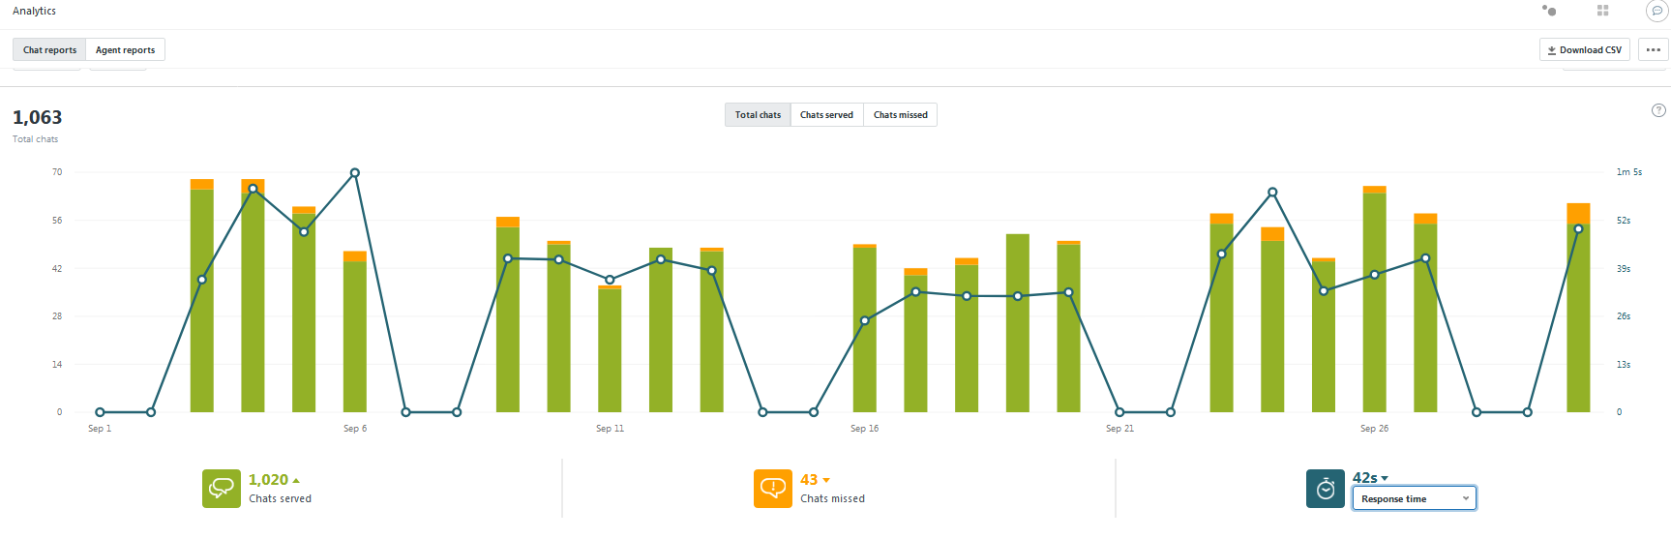
Live Chat by the Numbers
Notes:
As we mentioned above, it is for people with legal problems who have access to the Internet and who and are able to and comfortable in looking for information online
Information on common legal questions across 13 legal topics: housing, family, employment, debt and consumer rights, income assistance, criminal – some human rights, immigration
Each area of law is broken down into sub-topics with a list of questions
Where there are long lists of questions, you can filter them by topic
The answers don’t just speak to legal topics in generalized terms – they respond to specific commonly asked questions and provide practical steps that people can take to address their legal problems – or to avoid a legal problem
We know that different people are comfortable taking different steps, depending on their circumstances – designed to be flexible for different needs and capabilities of users
Our information has Direct Links:
Brings in information and content produced by others, including other clinics and various resources produced by government, LAO, courts and tribunals, and other organizations including CLEO – builds on legal information that’s already out there – not reinventing the wheel and wasting resources
Links to forms, checklists, self-help guides, services, other resources – so you do not have to leave the site to find these things when brought up in context
In terms of referrals, each question has a “Find services” section where we offer referrals to services across Ontario that people can go to for in person help – legal clinics, social and community services – example: centres for abused women and children
We also have the 211 site embedded on the Find Services page so you can find local referrals for wherever you are in the province
Page views in its first year -- about 700 k
Page views in 2018 – about 3.3 million
-also offers a Live Chat feature, which we’ll talk about in a couple of minutes

Slide 16
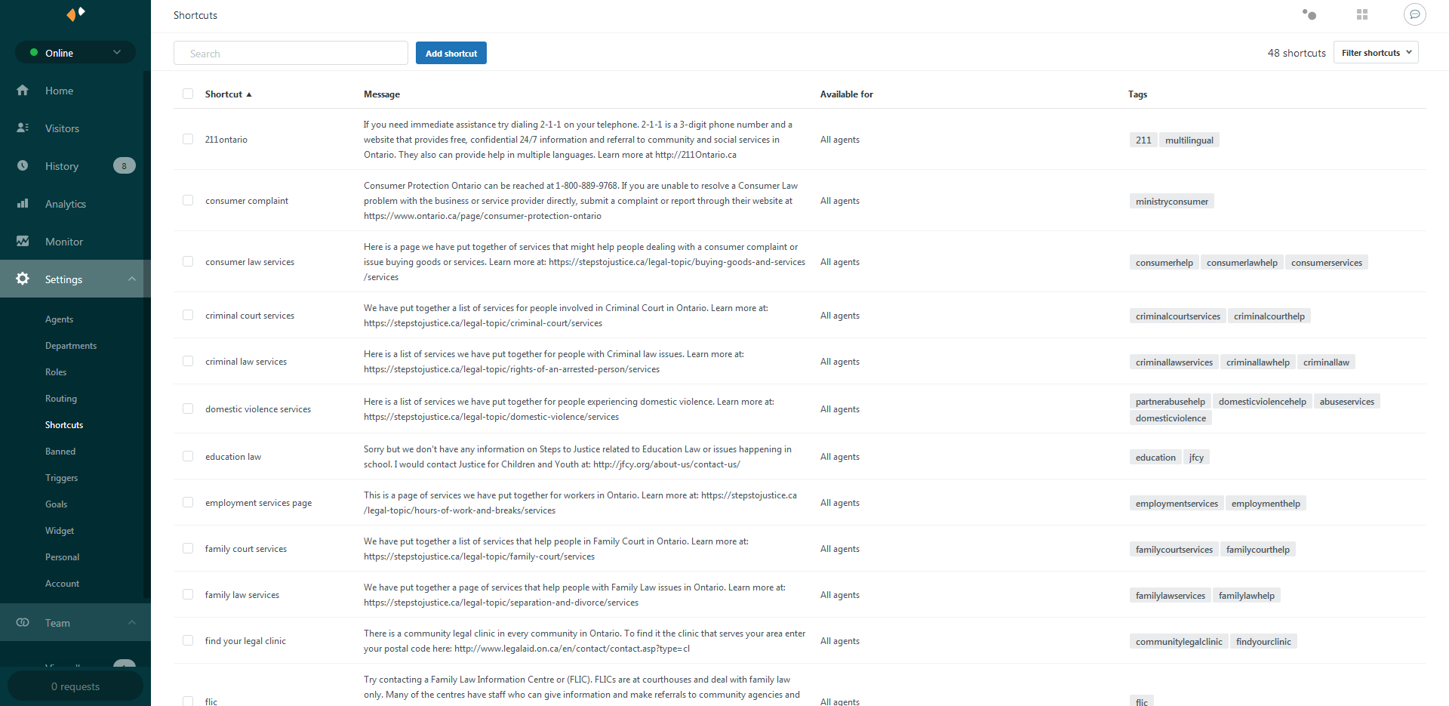
Shortcuts save us time and provide consistency

Slide 17
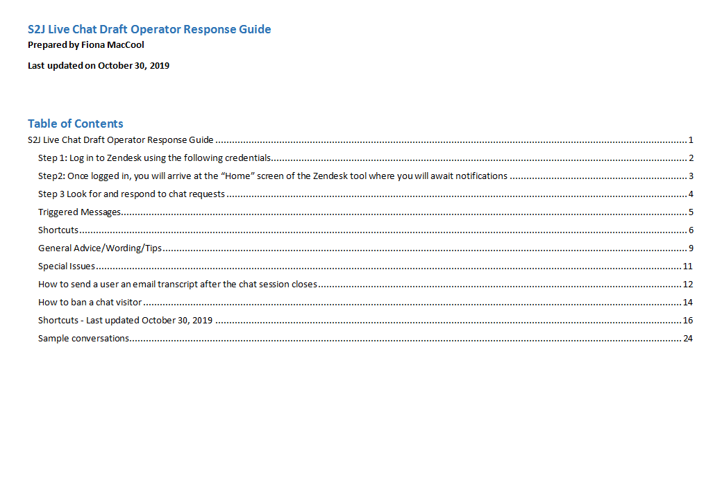
Constantly updated Operator’s Guide

Slide 18
THANK YOU!
Fiona MacCool
Digital Projects Manager
fiona.maccool@cleo.on.ca
stepstojustice.ca justicepasapas.ca

Slide 19

People’s Law School Chatbot
A few screen captures to show how the chatbot works

Slide 20
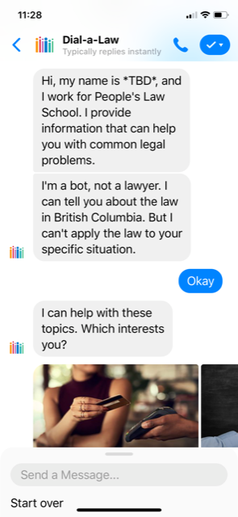
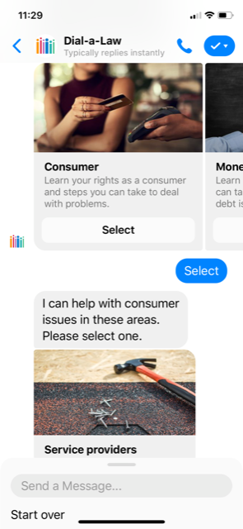

Slide 21
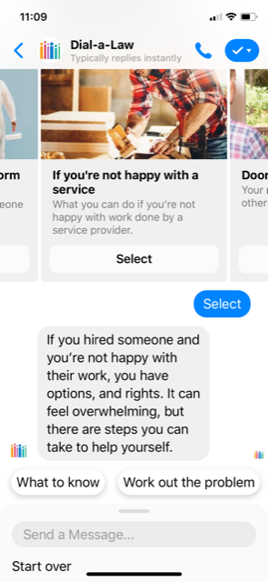
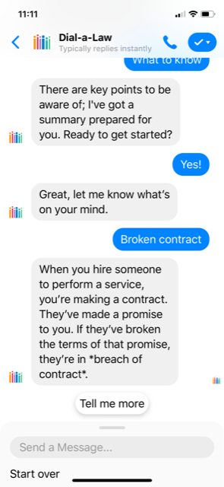

Slide 22
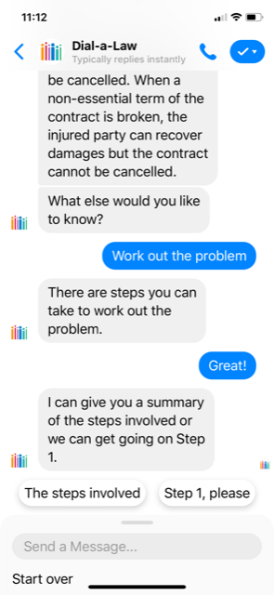
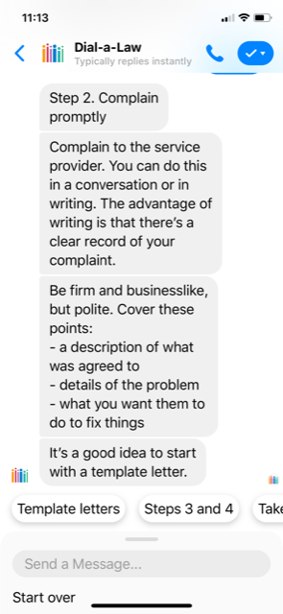

Slide 23
People’s Law School Chatbot
A few screen captures to show how the chatbot works

Slide 24
Using Design Thinking for Public Legal Education and Information
Civic Tech Toronto, Law & Design CoLab
Sam Horodezky, Law and Design CoLab
Alexis Knygavko, Law and Design CoLab
with comments from Amy Salyzyn, University of Ottawa

Slide 25
Community Forum: Considering the legal services exception for family, friends, and neighbours
Jessica Reekie, Ontario Justice Education Network
Julie Mathews, Community Legal Education Ontario

Slide 26
Providing Class P1 legal services without a licence
30. The following may, without a licence, provide legal services in Ontario that a licensee who holds a Class P1 licence is authorized to provide:
[...]
Acting for friend or neighbour
4. An individual,
i. whose profession or occupation is not and does not include the provision
of legal services or the practice of law,
ii. who provides the legal services only for and on behalf of a friend or a
neighbour,
iii. who provides the legal services in respect of not more than three matters
per year, and
iv. who does not expect and does not receive any compensation, including a
fee, gain or reward, direct or indirect, for the provision of the legal
services.
Acting for family
5. An individual,
i. whose profession or occupation is not and does not include the provision
of legal services or the practice of law,
ii. who provides the legal services only for and on behalf of a related person,
within the meaning of the Income Tax Act (Canada), and
iii. who does not expect and does not receive any compensation, including a
fee, gain or reward, direct or indirect, for the provision of the legal
services.
Law Society of Ontario
By-Law 4 - Licensing
s. 30

Slide 27




Closing Comments
With sincerest thanks to:
Law Society of Ontario
Law Foundation of Ontario
Community Legal Education Ontario
Ontario Justice Education Network
and our many community partners.

