Slide 1
Supporting community justice help and advancing access to justice
Access to Justice Week 2020
Julie Mathews (CLEO) & David Wiseman (uOttawa)

Slide 2
Our remarks today
Our report proposes that:
Community justice help should be recognized and supported as a means of improving access to justice
What is community justice help?
Why do we propose a ‘supporting and equipping’ approach?
What are the specifics of our proposed approach?

Slide 3
What is community justice help?
The help provided by staff* in not-for-profit community-based organizations to people experiencing life-affecting problems with a law-related element.
* and volunteers trained and supervised by staff

Slide 4
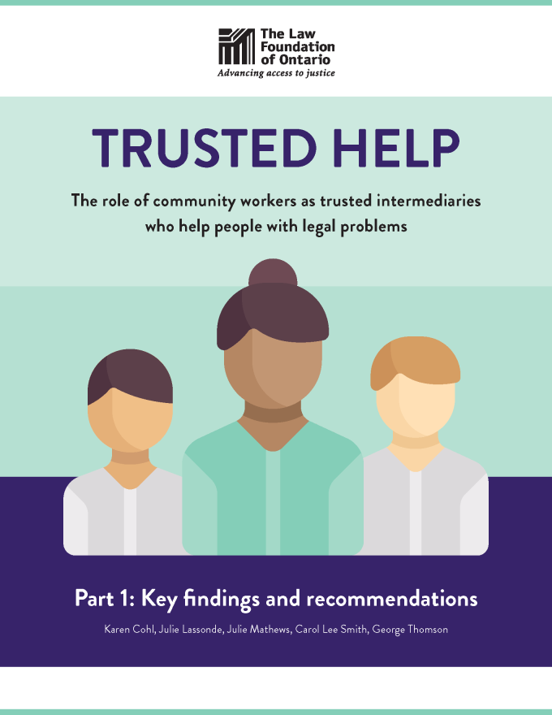
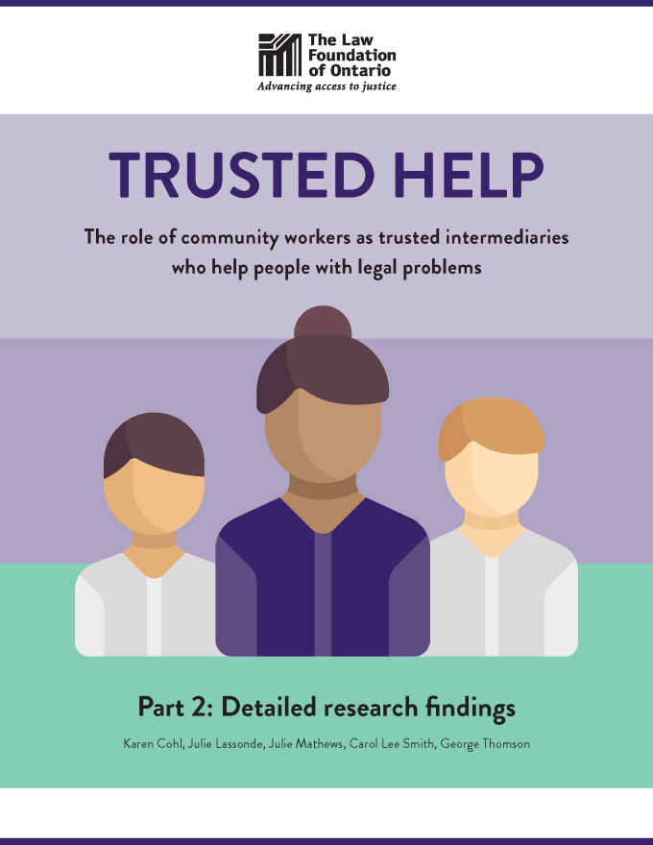
Trusted Help
Community workers as trusted intermediaries who help people with legal problems
https://lawfoundation.on.ca/news/legal-help-on-the-frontlines/
Study supported by the Law Foundation of Ontario

Slide 5
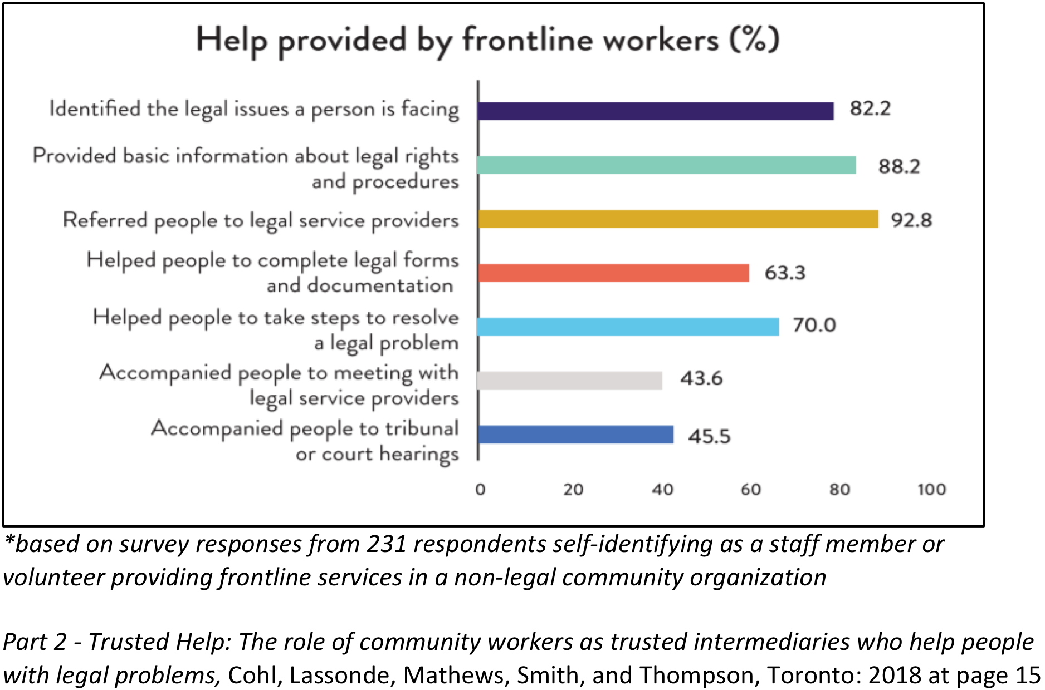

Slide 6
Why a ‘support and equip’ approach to community justice help?
Community workers provide ‘good quality’ help
Often: the only help that a person will access
But: some help is perceived* to fall on wrong side of regulatory ‘dividing line’
Legal information v Legal services
Discourages and undermines a source of good quality accessible help
* in Ontario: a misperception

Slide 7
Why a ‘support and equip’ approach to community justice help?
Goal: good quality and accessible help
→ Protecting the public interest
Quality assurance for community justice help:
Specialization matters: day-to-day experience …
Strong, existing quality assurance mechanisms in not-for-profit sector
Members of regulated professions or occupations
Participants in certification and accreditation
Also: no direct financial gain from clients

Slide 8
What we’re proposing
Support and equip community justice help, where three features are present…

Slide 9
Three features of a “support and equip” approach
“Good quality” help is where workers at a community-based organization:
Have the knowledge, skills and experience they need;
Are working within a not-for-profit organization and an ethical infrastructure;
Are providing support that responds to their clients’ needs in a holistic way

Slide 10
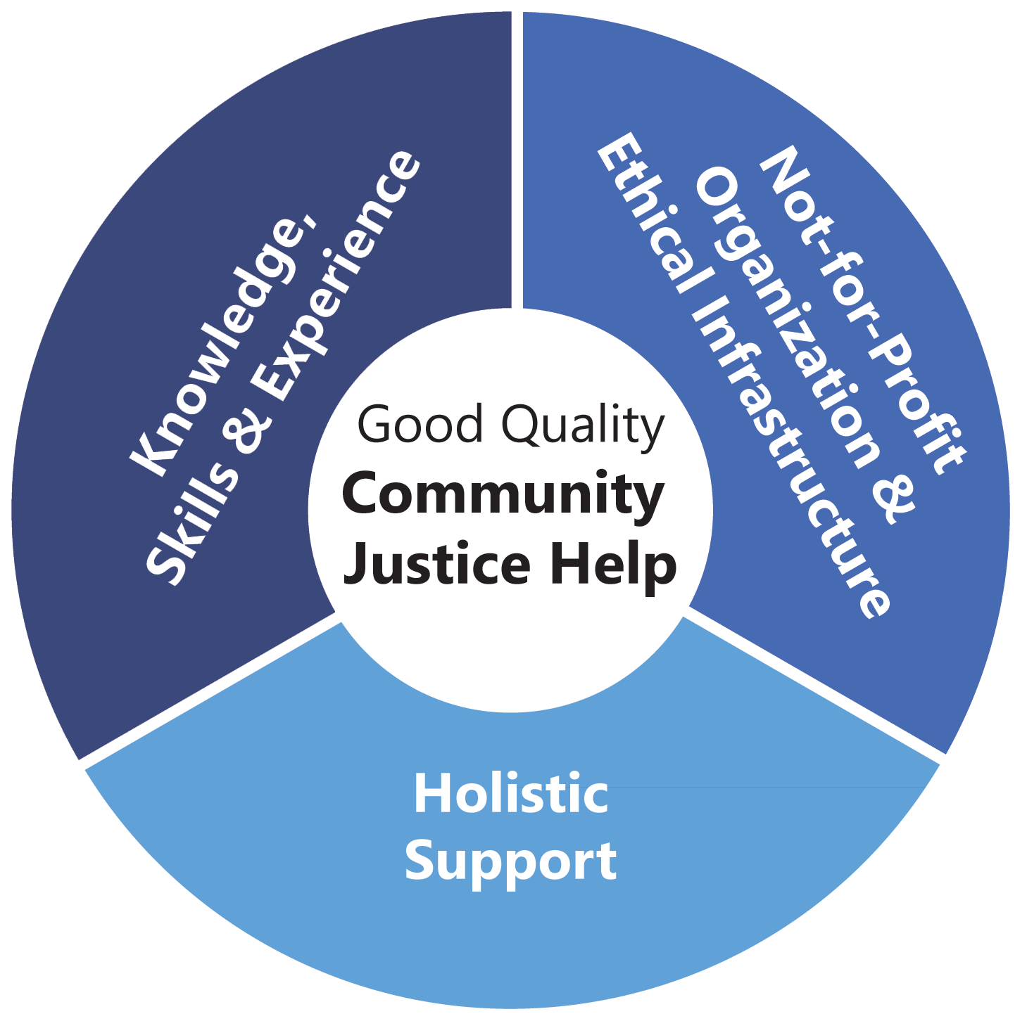

Slide 11

Markers:
Organization specializes in providing help with these types of problems
Staff have comprehensive, up-to-date knowledge base
The organization and its staff are well supported and connected, and receive appropriate oversight

Slide 12
More markers:
The organization has relationships with expert legal professionals whom they can and do call on as needed
Staff help people with forms or other tasks that many people would expect to be able to do on their own or with some limited assistance (not requiring a lawyer)

Slide 13

Aim: protect clients’ dignity, privacy, and welfare
Markers: where organization …
operates as a not-for-profit – the organization’s staff do not accrue direct financial gains from clients
has an accountability structure in place (usually overseen by a board of directors) to ensure that the organization is operating per its policies

Slide 14
More markers of second feature
More markers: where organization …
has proper policies and practices in place on key ethical issues – for example, on client confidentiality and a code of conduct
has a complaints policy, accessible to clients and monitored and responded to appropriately
has a liability insurance policy in place that provides for compensation to clients in the event of negligence

Slide 15

Markers: ‘Holistic’ support means …
Awareness of:
Multi-dimensionality of problems;
Social context of clients’ lives;
Levels and types of specialization or expertise required;
Need for and availability of targeted, timely and joined-up services;
Barriers to accessing other potential providers of assistance in the community (incl. lawyers); and
Follow-up and longer-term support available from the organization or from others

Slide 16
More markers: ‘holistic’ support also means …
Addressing community justice needs that are frequently unmet or underserved by licensed legal professionals available and accessible in the community
Connecting to and supporting good quality legal services from local licensed legal service providers, where such services are available and accessible to people in the community

Slide 17
Overarching recommendations
Community justice help should be recognized as an important and valid component of the broader ecosystem of access to justice services
Ecosystem includes a well-resourced legal aid system and, in Ontario, community-based legal clinics
Ontario’s regulator should recognize and confirm that community justice help is permitted under its rules
Practical tools and resources should be developed to support this work, led by organizations providing community justice help working in partnership with legal organizations

Slide 18
Some next steps
Complete literature review exploring shift towards community justice help, funded by DOJ (early 2021)
Gather feedback on the Discussion Paper
Consult with interested community organizations/ sectors about next steps, for example:
More research / scans on particular aspects (existing quality assurance mechanisms/ regimes?)
Collect “best practices” currently in place for training, supervising, mentoring community justice helpers
Collect and review competency profiles in use in community sectors
Collect and analyze relevant CJH program evaluations

Slide 19
Engage and participate
Send us feedback at communityjusticehelp@cleo.on.ca
Law Society of Ontario is hosting roundtables – coming soon! – https://lso.ca/theactiongroup/home
Visit CLEO Connect, Ontario’s hub that supports community justice helpers: https://cleoconnect.ca

Slide 20
Discussion questions
What is missing in the proposed approach to community justice help? What has not been considered?
The report lists several markers of good quality community justice help. Are there markers that you would add? Are there markers that stand out?
What types of training and supports do you think are most needed by “community justice helpers” in Ontario? How can they be developed? Can you suggest any current training or supports as examples?
Do you think a system for monitoring quality of “community justice help” needs to be put into place? If so, who should run it? If not, what approaches can be used to encourage or support a culture, network, or commitment to community justice help?
Are you aware of models in other fields, or in other jurisdictions, that promote and give some assurance of good quality in the provision of important services to the public?

Slide 21
Community Justice Help papers
For background papers:
Read the full report: “Community Justice Help: Advancing Community-Based Access to Justice”
Read a summary of the full report
View a short version of the framework
Send feedback to communityjusticehelp@cleo.on.ca

Slide 22
THANK YOU!
Julie Mathews
CLEO Executive Director
julie.mathews@cleo.on.ca OR
communityjusticehelp@cleo.on.ca
David Wiseman
Professor uOttawa Faculty of Law
More on community justice help (full report and summaries):
https://cleoconnect.ca/cleo-research/learn-about-community-justice-help/

