Slide 1
How You Can Help Your Clients Access Toronto’s Government-Subsidized Family Information
& Mediation Services
October 29, 2020

Slide 2
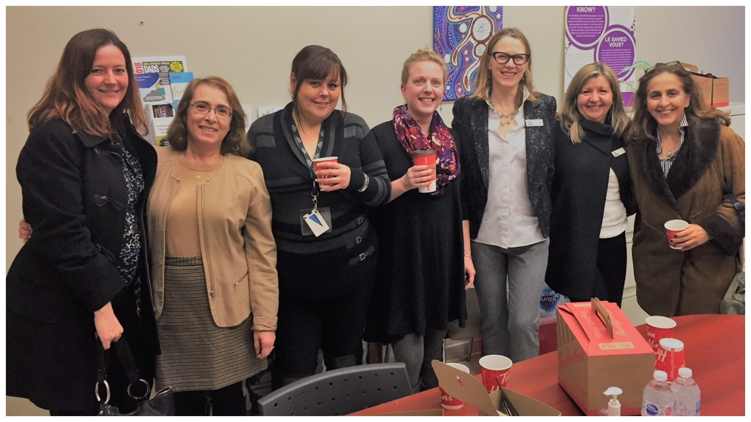
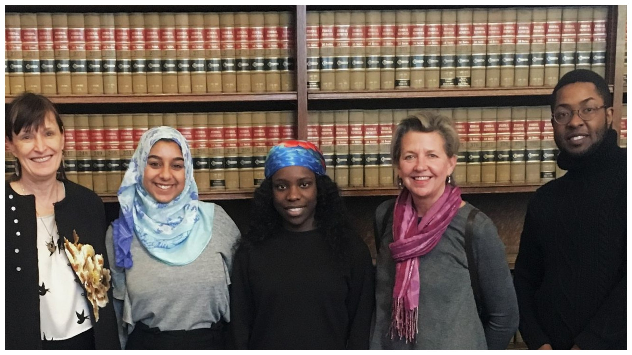
Welcome to mediate393!
We provide a broad range of free and subsidized services to Toronto’s separating families. Funded by the Ontario Ministry of the Attorney General, all of our services are available virtually.

Slide 3
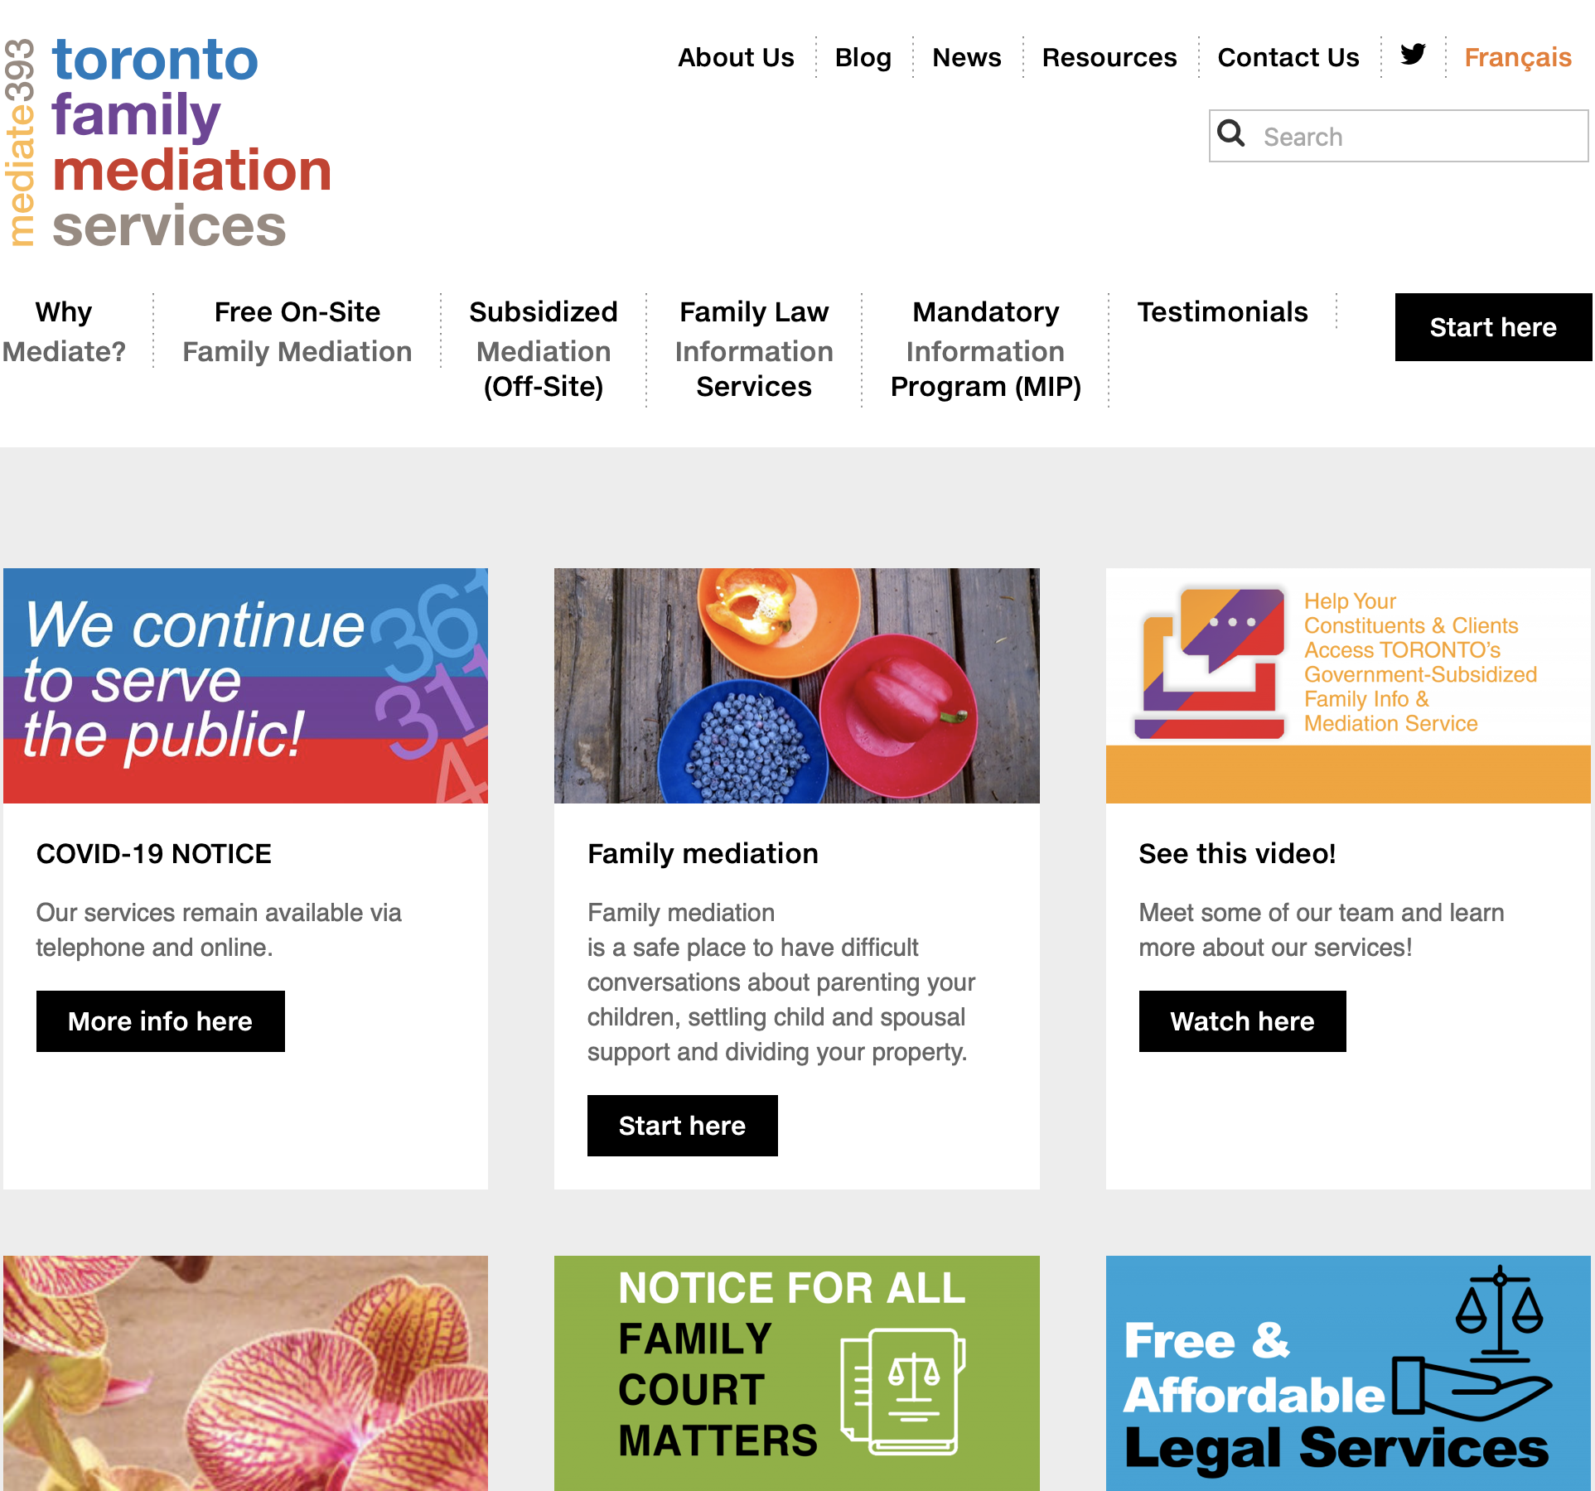
Our comprehensive website can help you and your clients find the services they are seeking

Slide 4
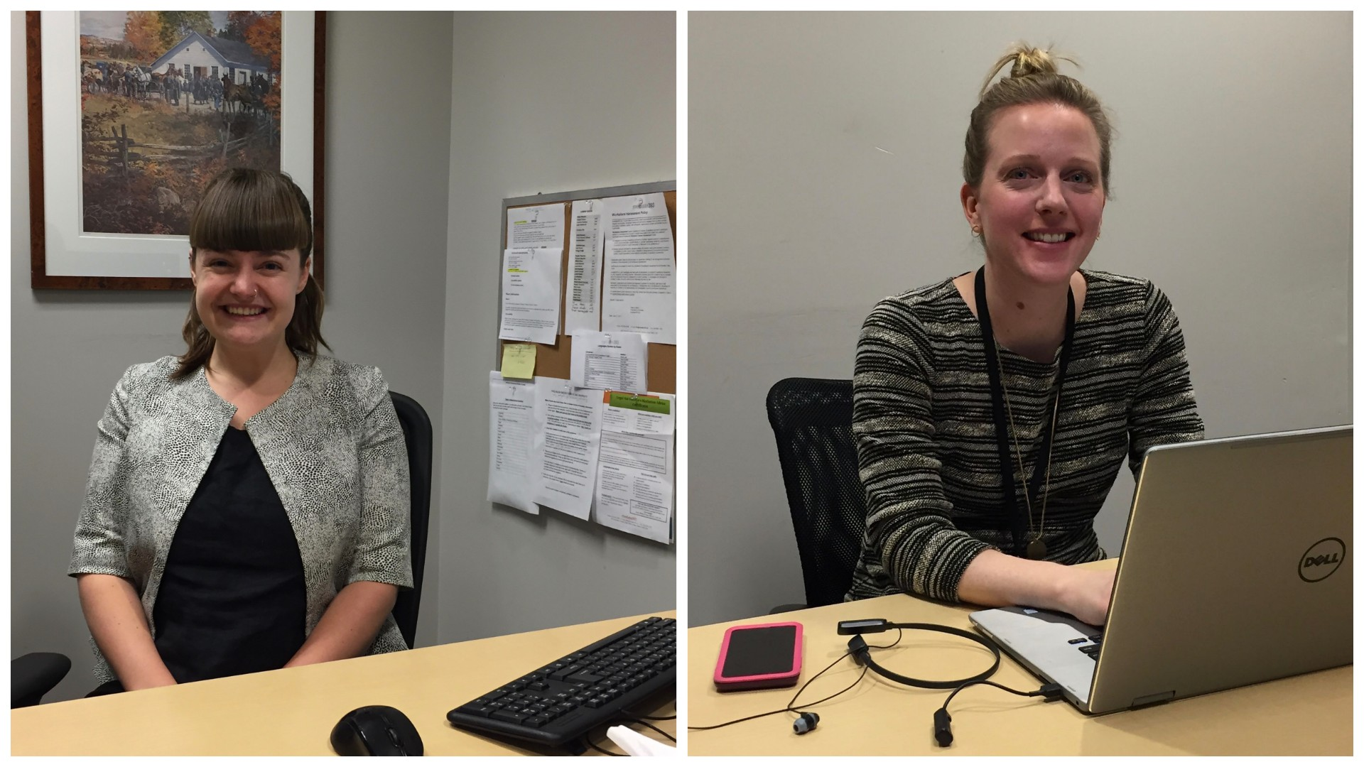
Free Family Law Information Services
Our Information & Referral Coordinators are available by phone and email 9-5 daily.
Anyone can call the IRC about court process and forms; how to access mediation; domestic violence supports; resources for mental health, family counselling, interpreters, supervised access centres, drug, alcohol and paternity testing, and more.
We have a network of community agencies we refer to daily.
When the courts re-open, our IRCs will be at Toronto’s OCJ Courts (311 Jarvis and 47 Sheppard) and its SCJ Court (361 University.)

Slide 5
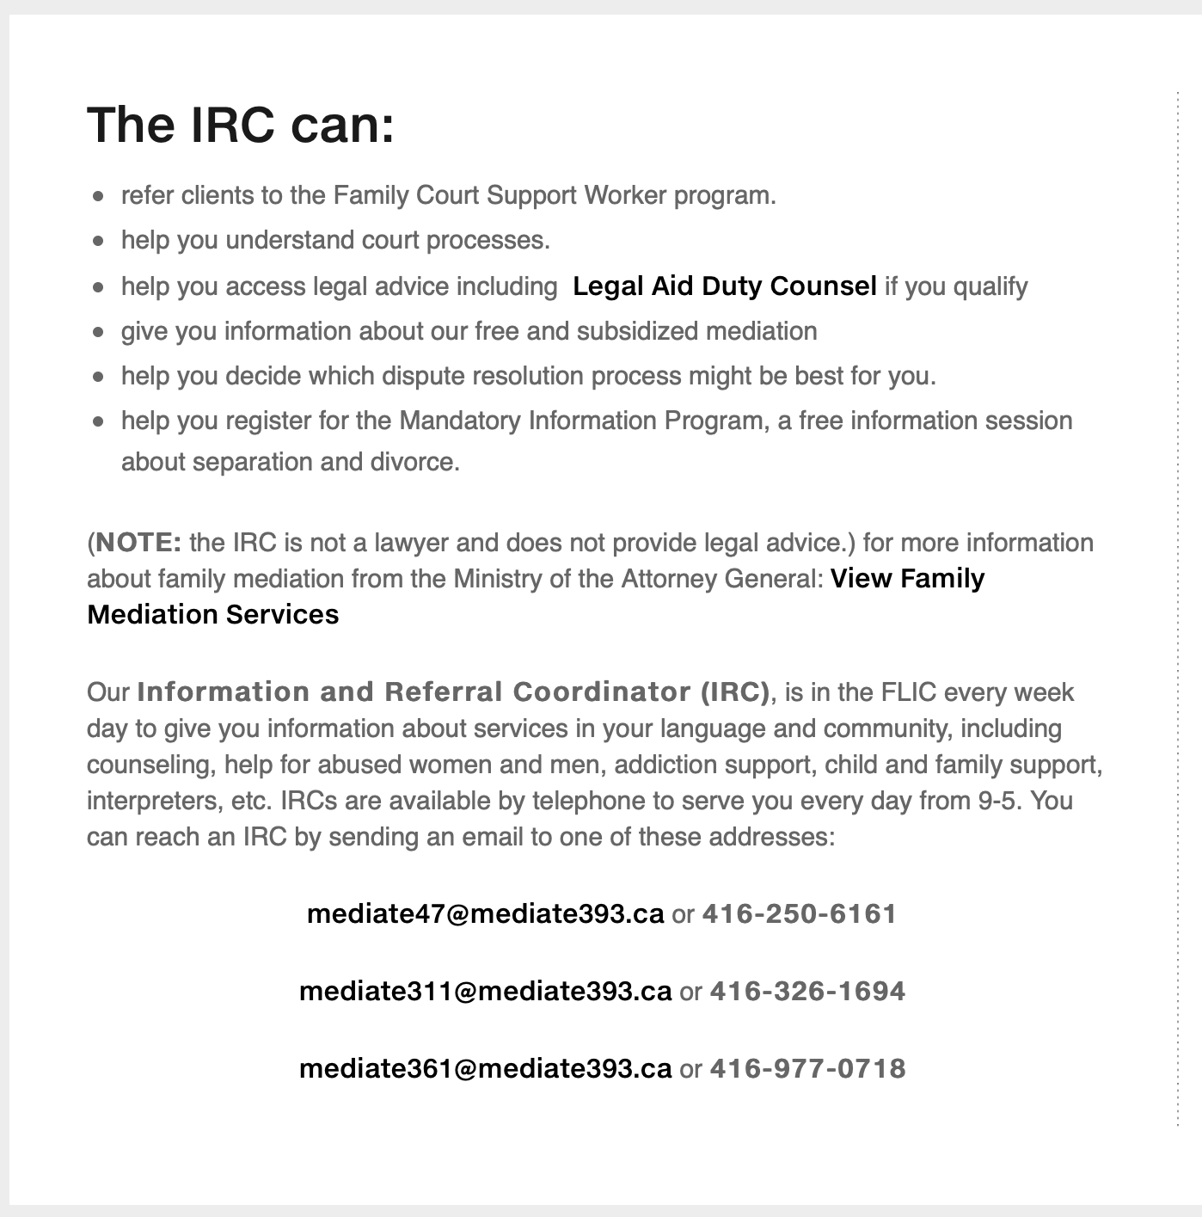
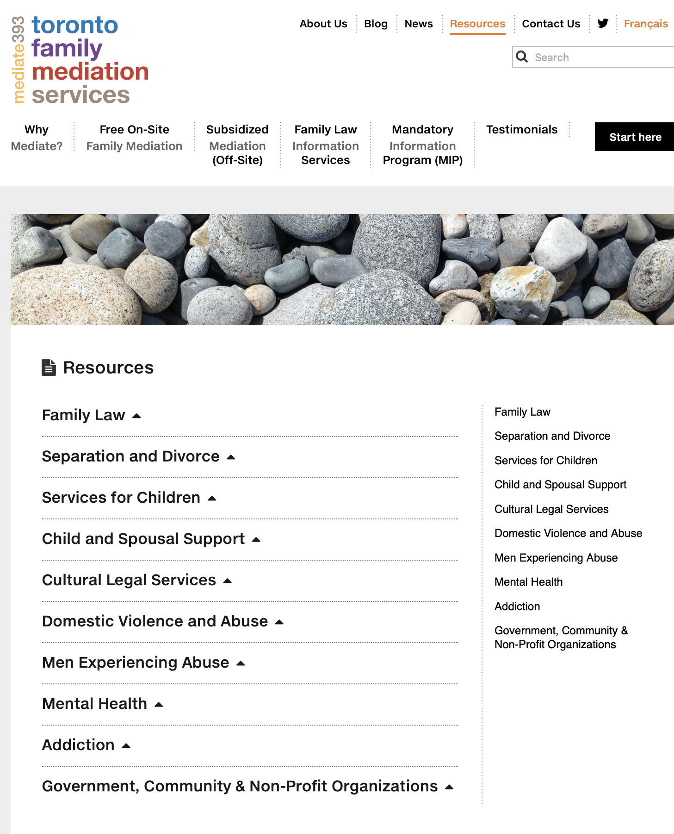
Our IRC can provide you with general legal information and referrals to community services

Slide 6
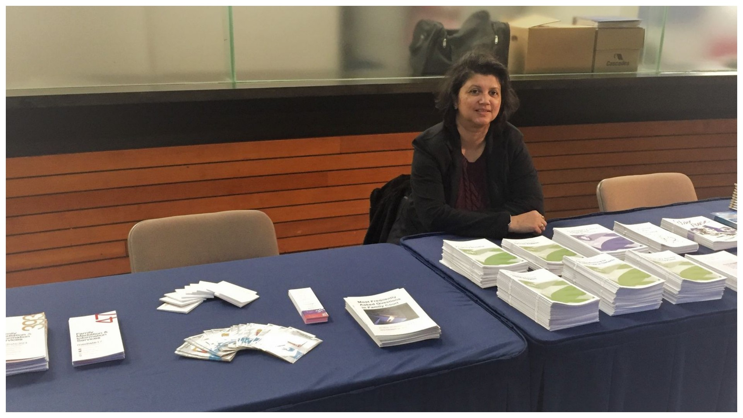
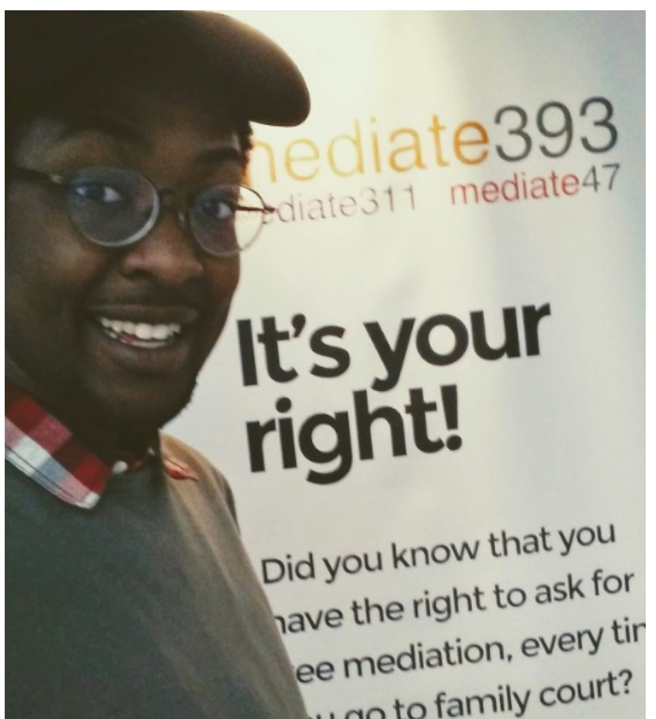
Mandatory Information Programs
These valuable information sessions are free to everyone, and are required for all who seek to bring a matter to court.
They are provided by way of a twice weekly webinar.

Slide 7
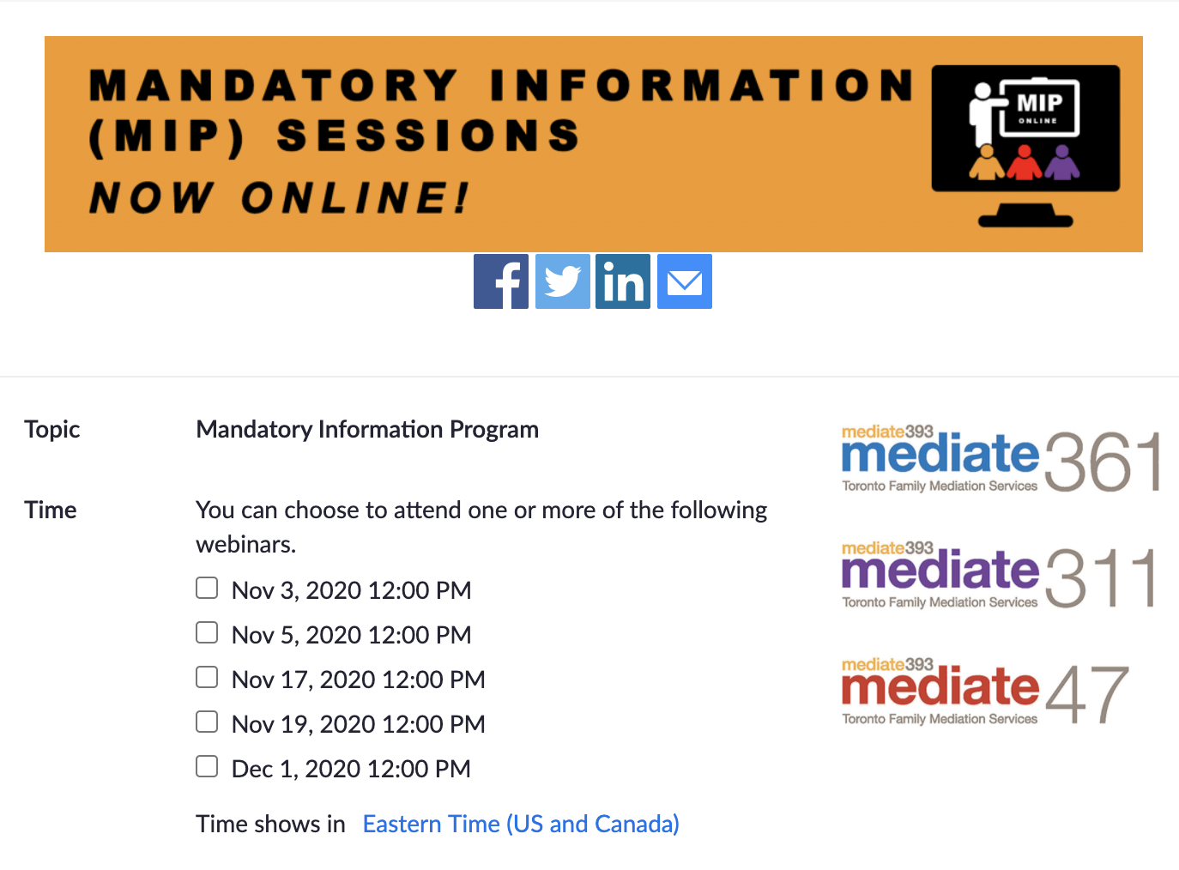
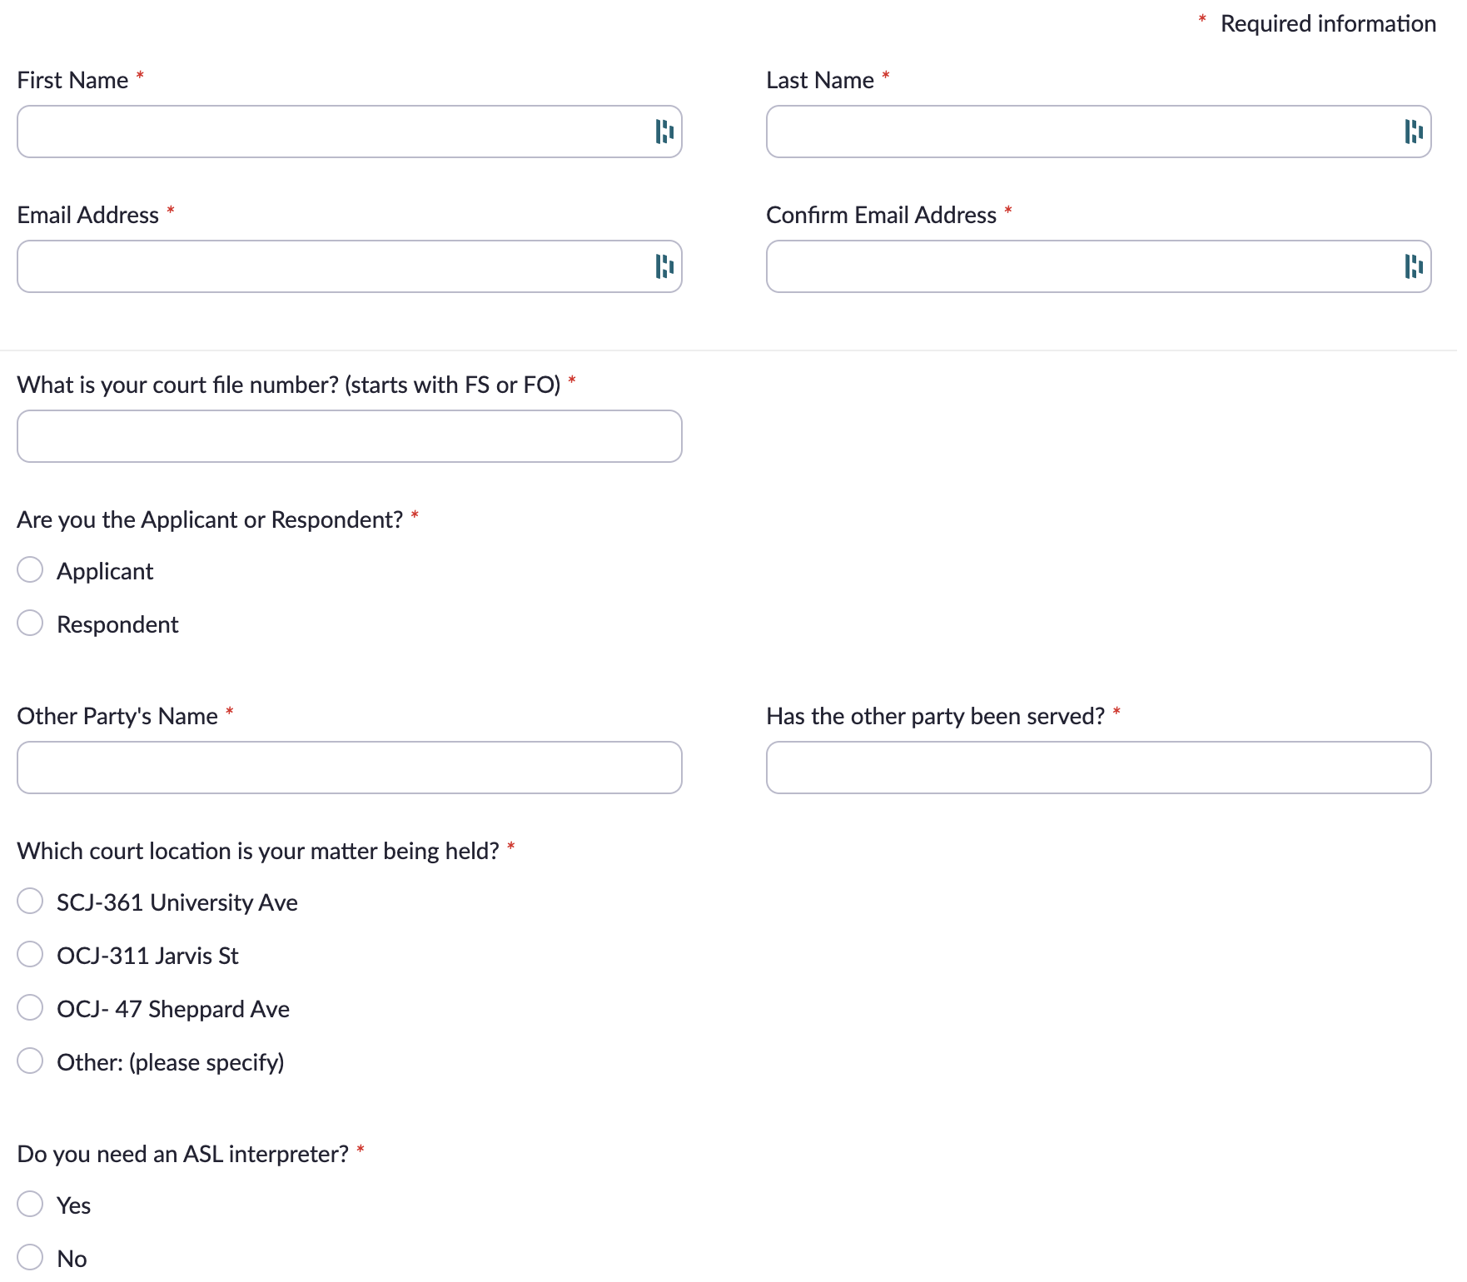
Clients can register to attend the MIP directly on our website

Slide 8

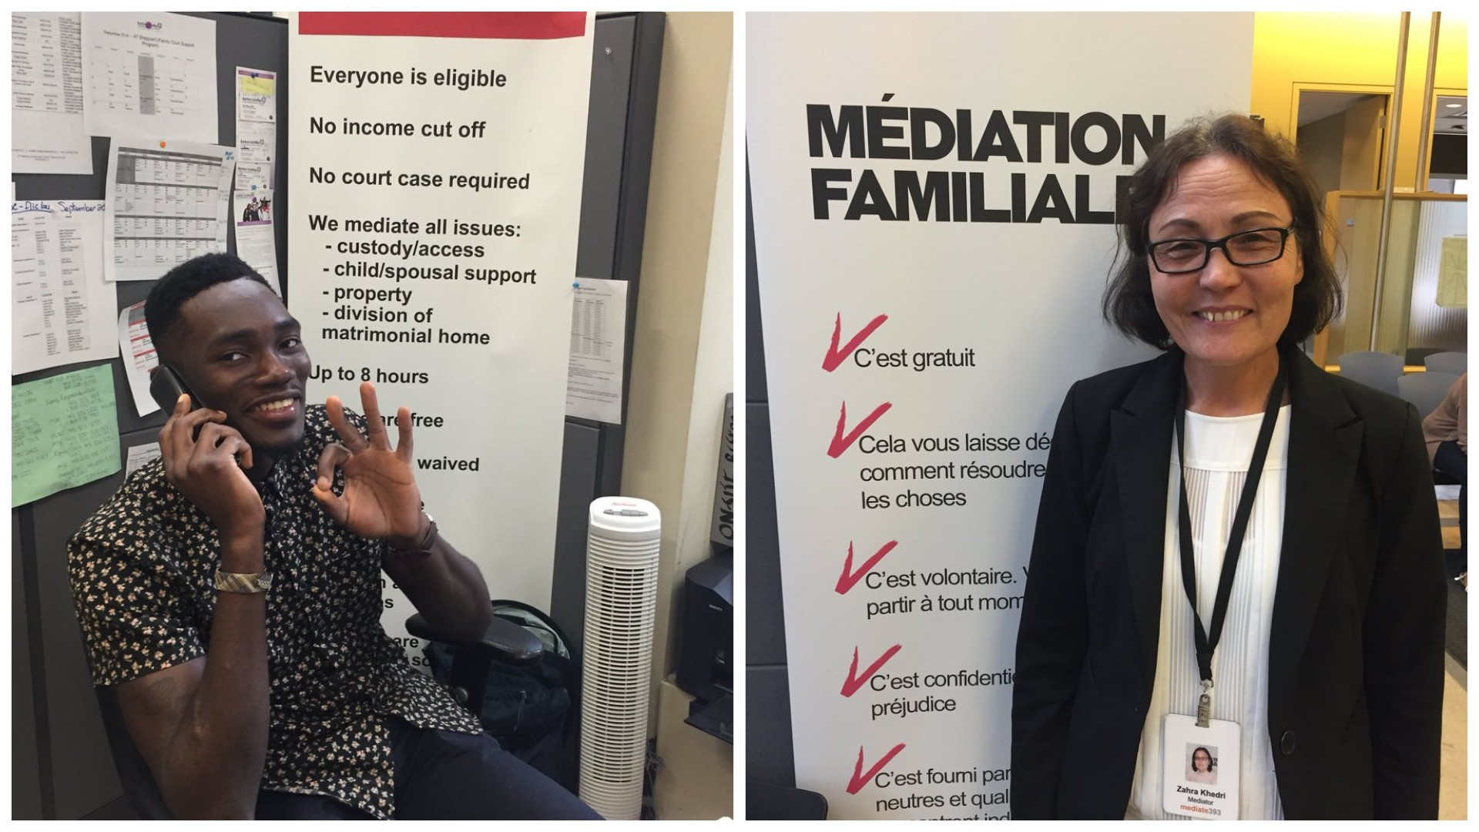
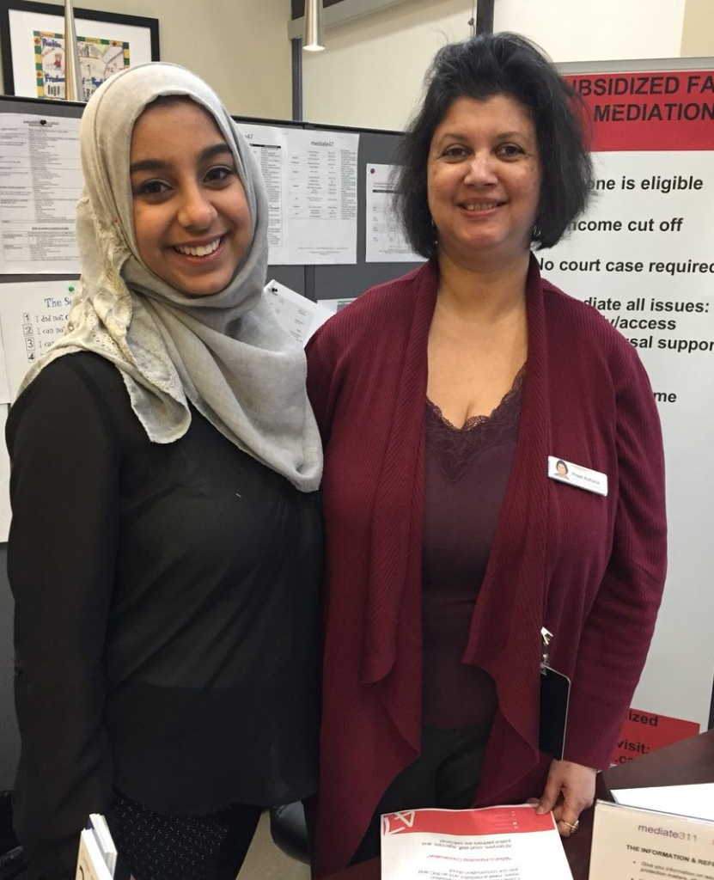
We have many languages!
We offer all our services in English, en francais, and ASL, and in other languages too where possible including…
Bengali, Gujarati, Hindi, Urdu, Farsi, Ukranian, Spanish, Italian, Portuguese, French and Punjabi

Slide 9
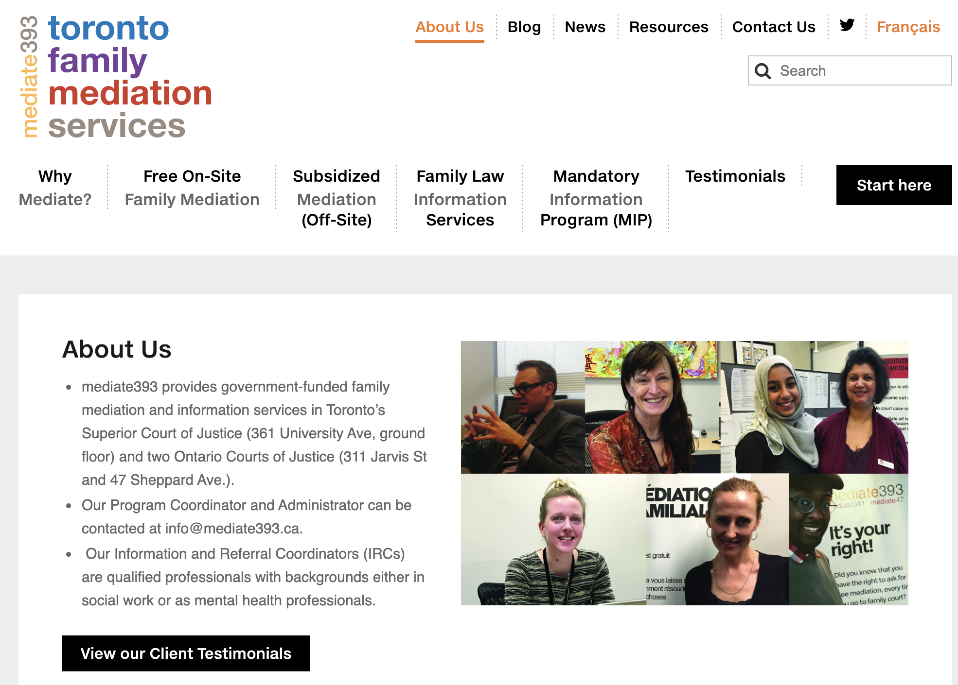
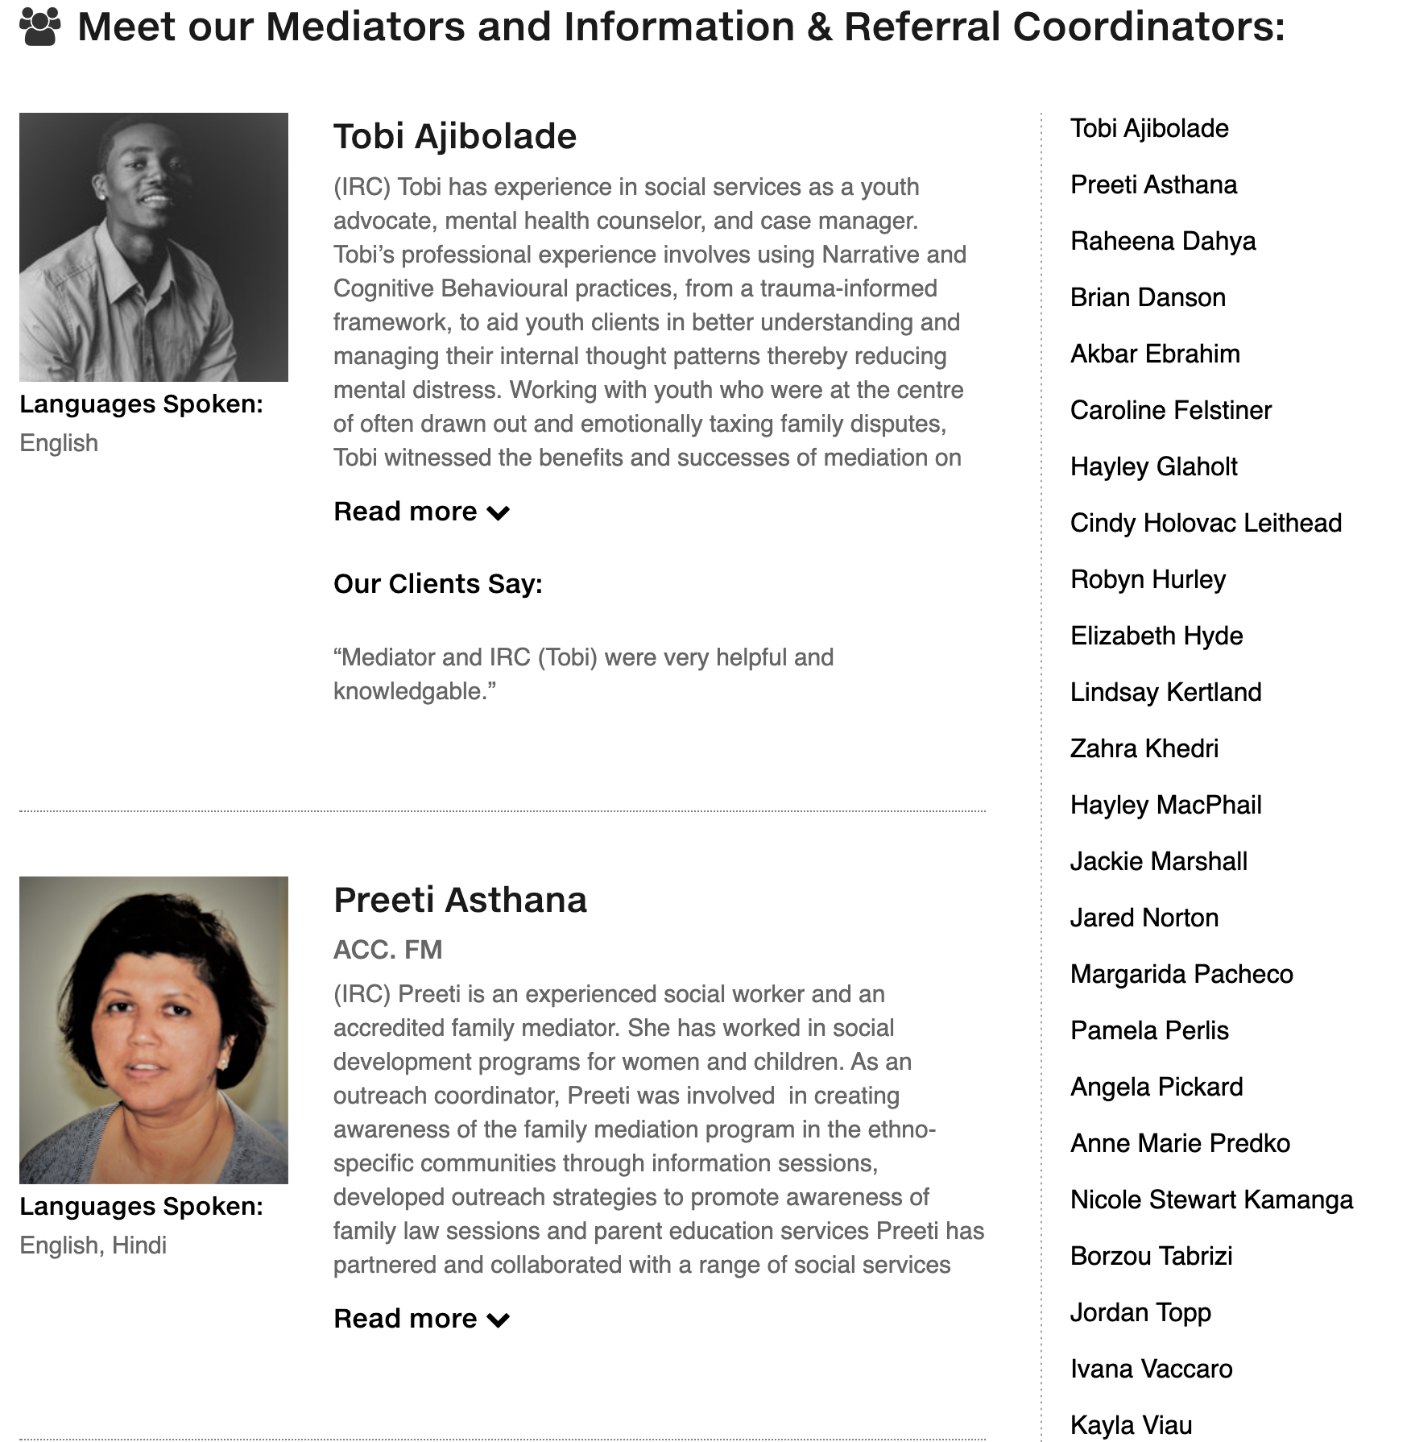
Meet our Team by navigating to the About us page

Slide 10
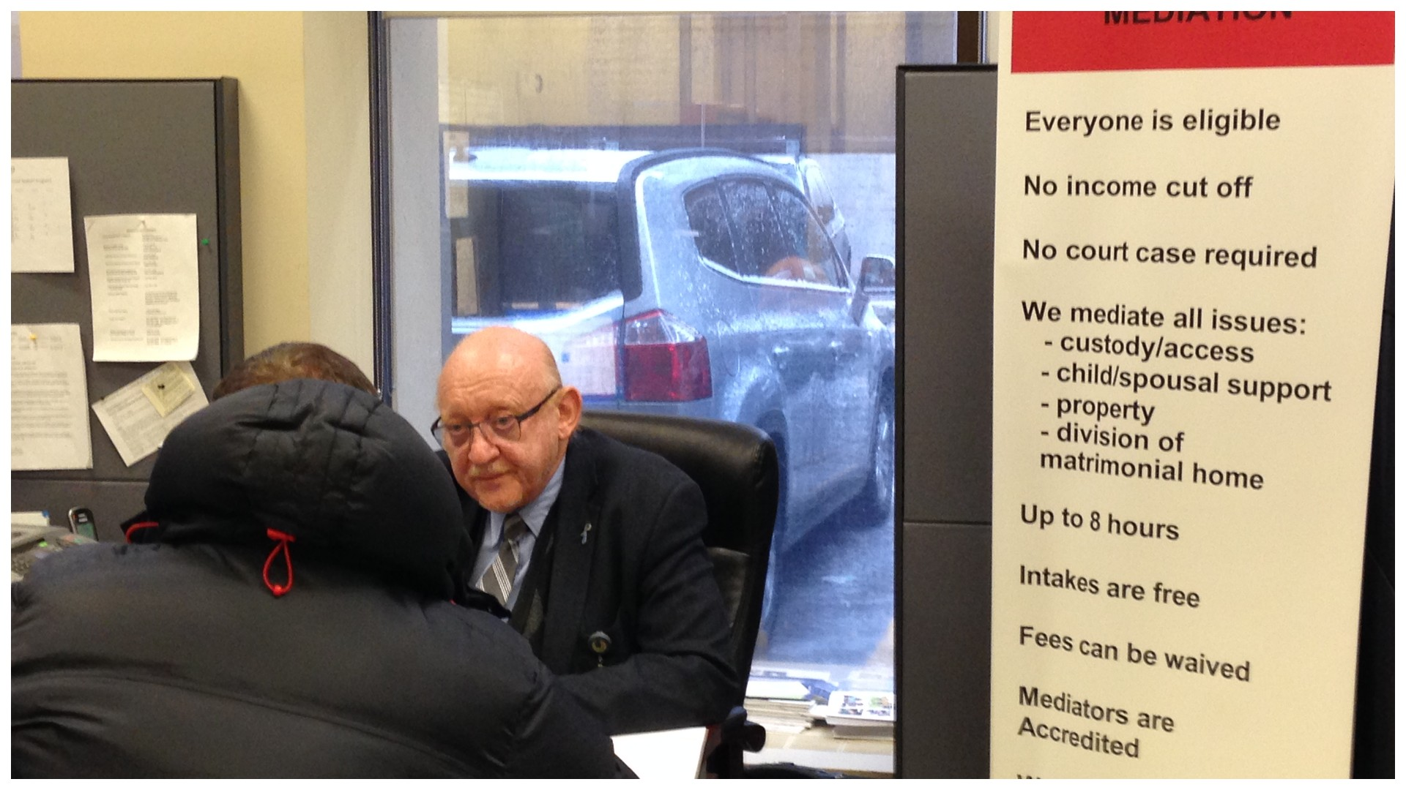
Free mediation for everyone in court
Anyone with a court motion, conference or trial can ask to meet with the ‘on-site’ mediator if they want to try to settle the case.
We successfully mediate child support, parenting plans, spousal support, property division, and more.
This virtual service offers 2-3 hours of
free mediation.

Slide 11
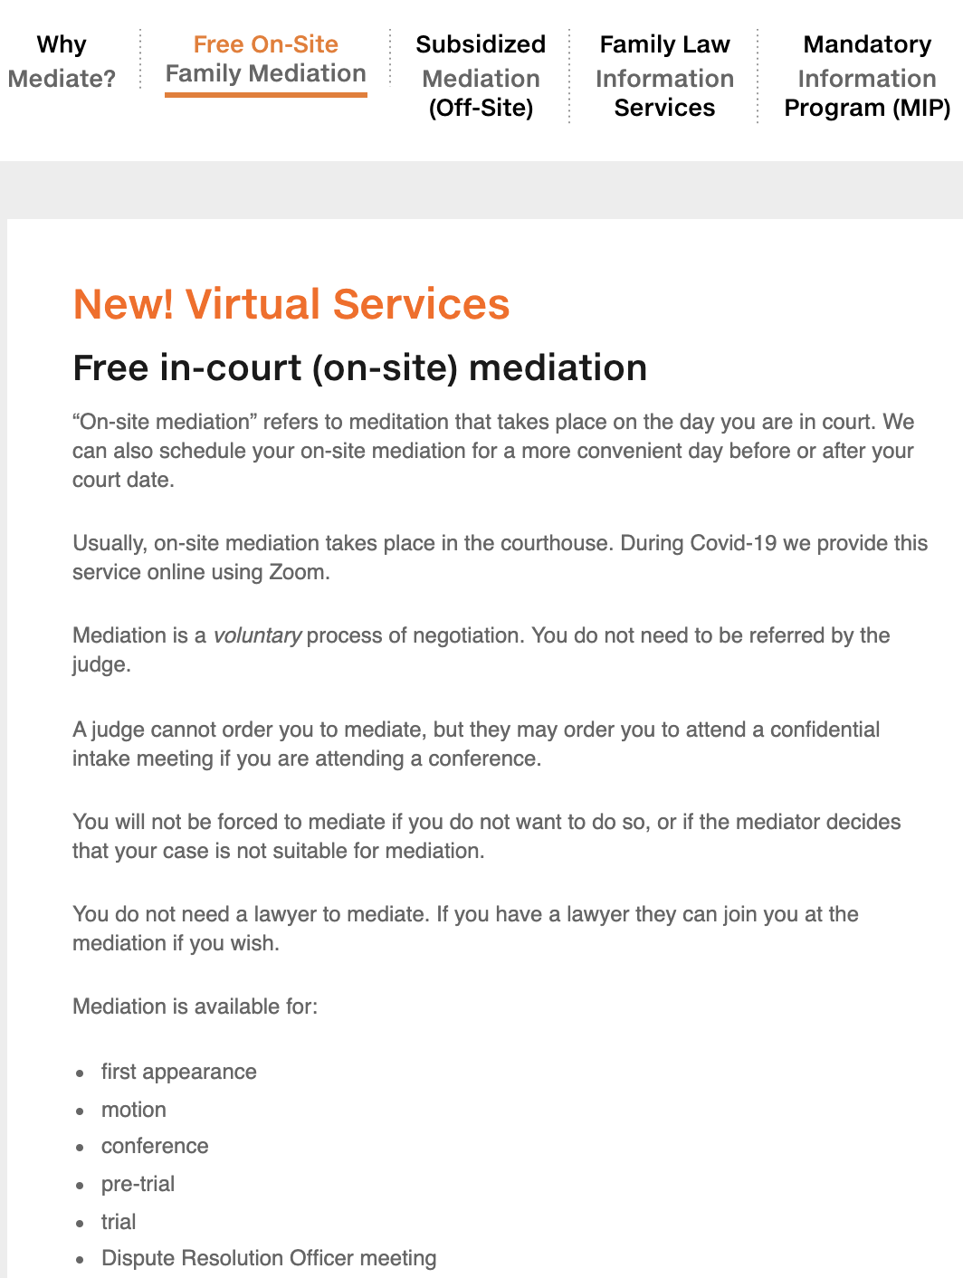
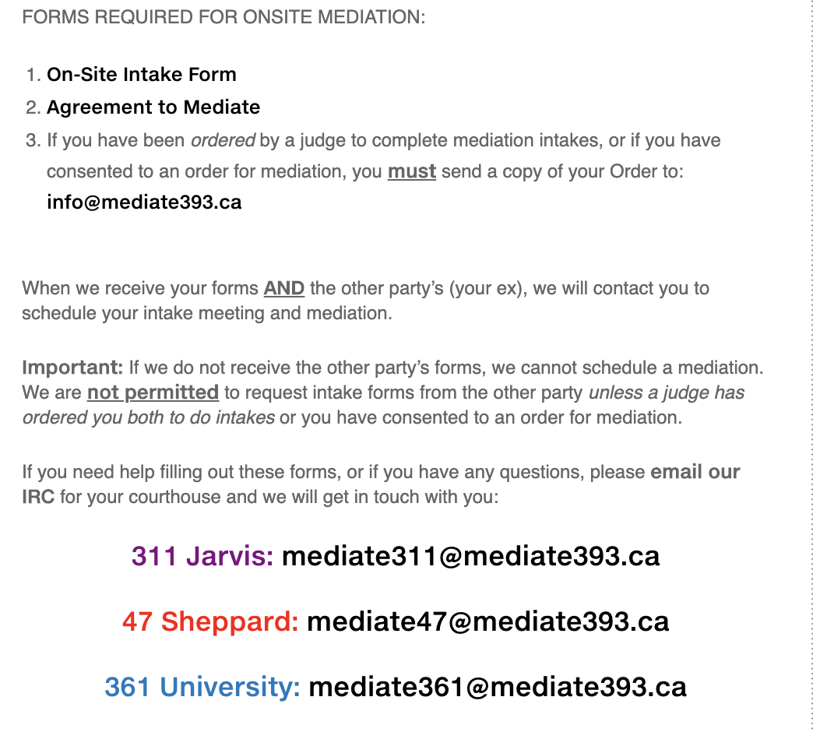
During Covid-19 we provide on-site mediation services online using Zoom

Slide 12
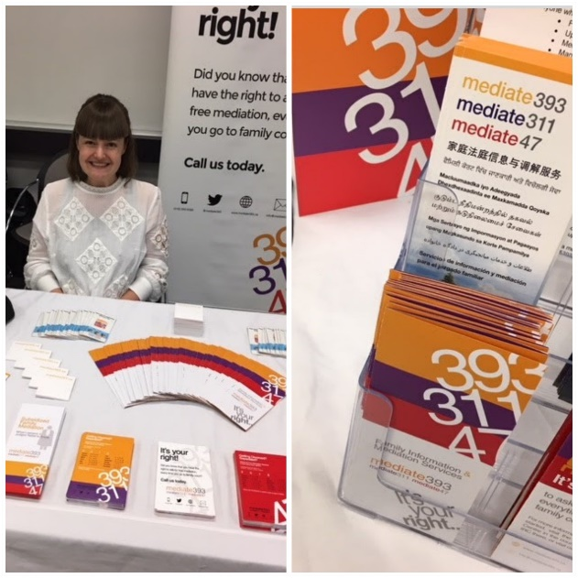
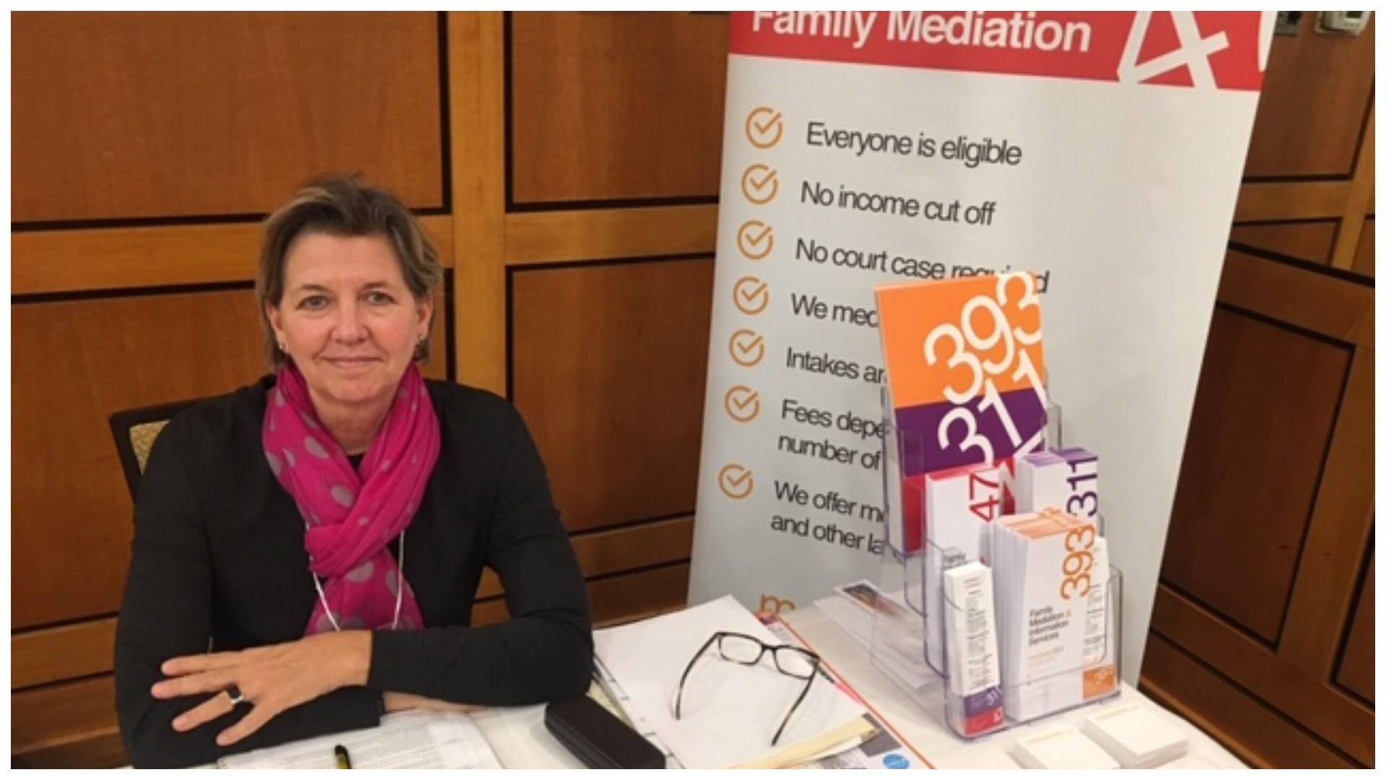
Subsidized mediation for everyone
Many people do not know that family mediators will mediate with anyone in the Toronto area who wants to make a separation agreement with their ex spouse.
It is not necessary to have a court file.
We offer free intake meetings and 6 hours of
subsidized mediation if the matter is appropriate.

Slide 13
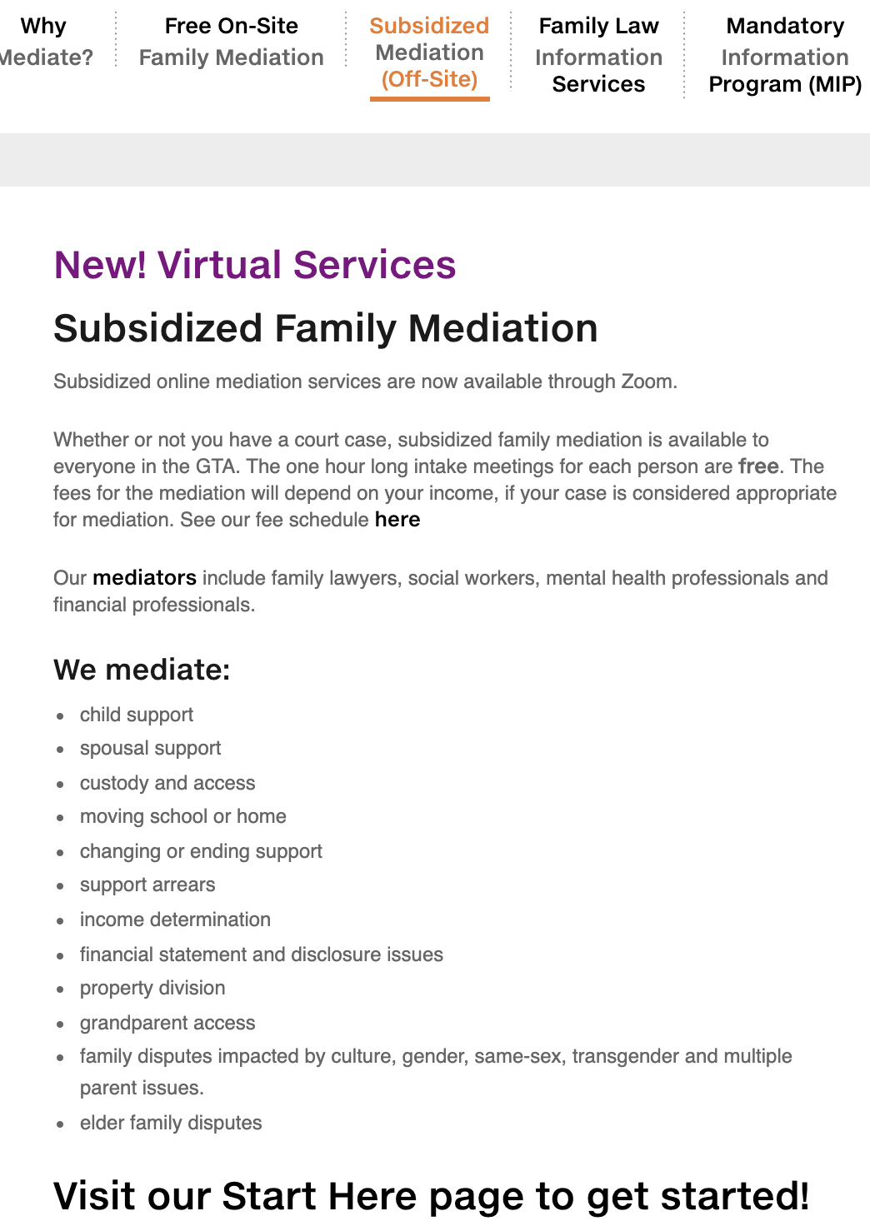

Our mediators include family lawyers, social workers, mental health professionals and financial professionals.
Click here to get started with subsidized mediation!

Slide 14
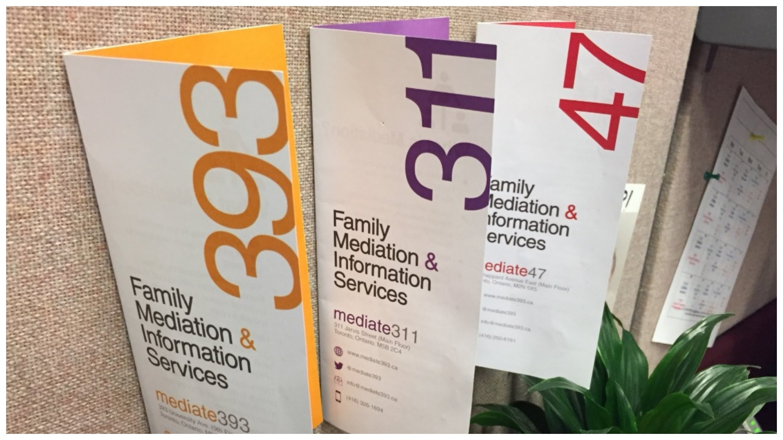
We serve all clients
Our mandate is to accommodate everyone
possible.
Our highly skilled professionals are trained to identify risk associated with domestic violence, and to assist clients with safety planning and referrals where appropriate.
We are bound by Ontario’s Human Rights Act, and compliant with the Accessibility for Ontarians with Disabilities Act.

Slide 15
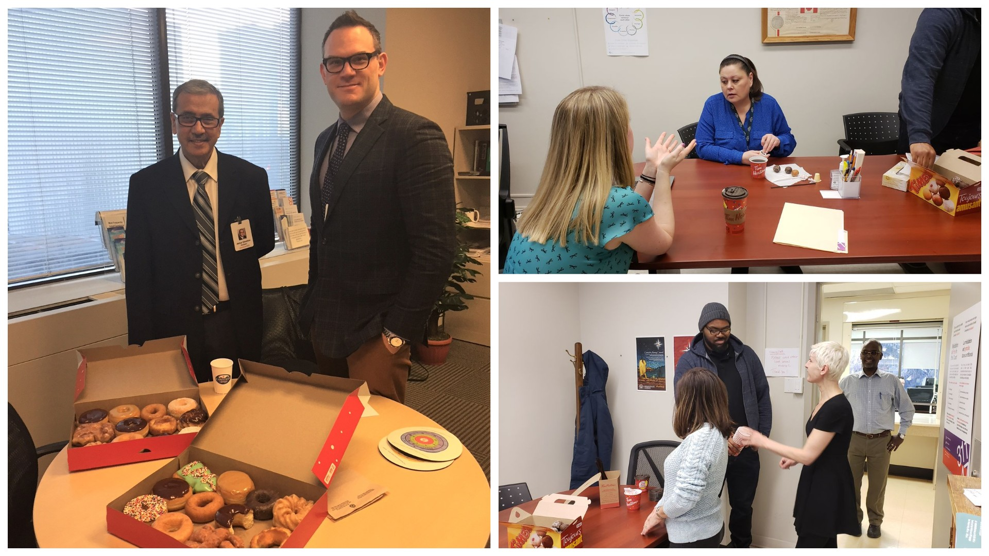
Our services are relevant and useful
Our professionals have ongoing training
in issues of race and gender awareness,
domestic violence and power imbalance, suicide prevention, Indigenous perspectives and experiences, mental health challenges facing our clients, dealing with very high conflict and family law.

Slide 16

We are successful and popular!
Our on-site mediation settlement rates last year averaged 81% full or partial settlement (OCJ); 65% (SCJ)
Our client satisfaction rates from January - March 2020:
89% “satisfied” or “very satisfied”.

Slide 17





What Our Clients Are Saying About Us!
I am happy that this service is available for families.
I am grateful
that the Government of
Ontario provides free resources
for people to understand
and start their
journey... Thanks!
Your staff was very helpful
and most importantly showed passion in what she does.
Your staff are wonderful.
Very understanding and
helpful. Much appreciated!
The mediator was patient, knowledgeable and understanding. He worked hard at helping us set an access schedule.

Slide 18
How to Access our Services

Slide 19
Free Family Law Information
Information & Referral Coordinators (IRCs) are available daily from 9-5.
If you already have a court case:
    47 Sheppard Ave | mediate47@mediate393.ca
    311 Jarvis St | mediate311@mediate393.ca
    361 University | mediate361@mediate393.ca
If you do not have a court case, write to info@mediate393.ca or call 416-593-5393.

Slide 20
Online Mandatory Information Services
Live video Mandatory Information Programs (MIPs) are offered biweekly on Tuesdays and Thursdays at 12:00 pm using Zoom webinar technology. Registrants may register on our website..
We provide the MIP in English, French and ASL. Parties may also attend with an interpreter.
Some parties may be able to attend the Legal Aid Ontario online MIP.
An IRC can help you learn more.

Slide 21
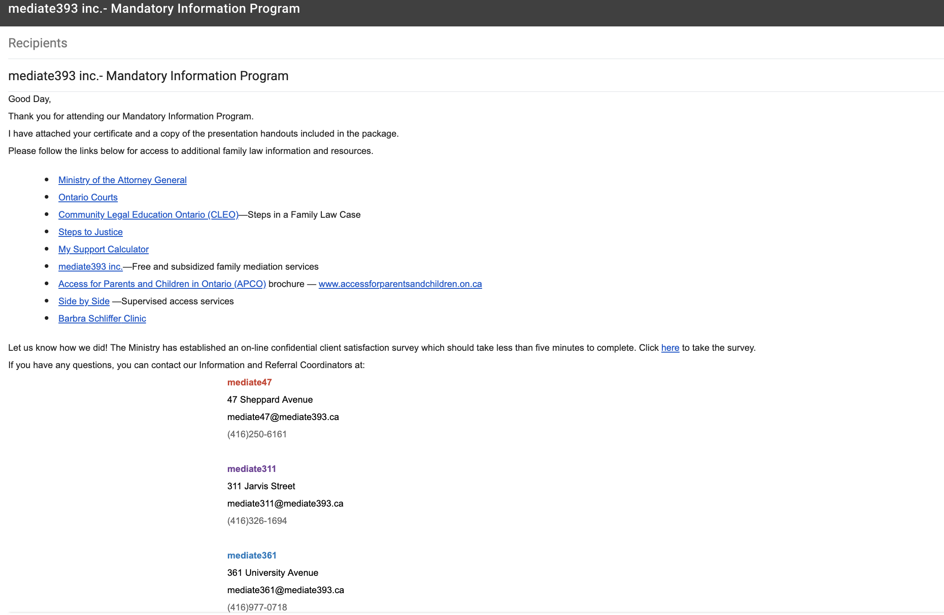
We email MIP attendees a Certificate of Attendance along with a list of valuable resources

Slide 22
Please contact the IRC for more information at:
mediate47
47 Sheppard Avenue
mediate47@mediate393.ca
(416)250-6161
mediate311
311 Jarvis Street
mediate311@mediate393.ca
(416)326-1694
mediate361
361 University Avenue
mediate361@mediate393.ca
(416)977-0718
Clients can register by emailing an IRC, calling 416-593-5393 or via our website.

Slide 23
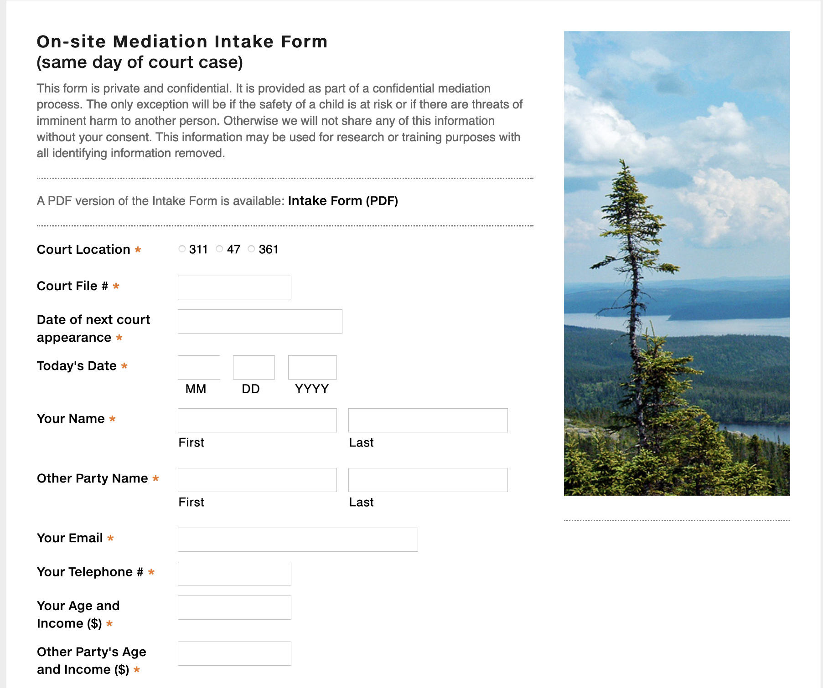
FREE ON-SITE MEDIATION:
Online mediation (about 2-3 hours) for anyone with a scheduled court appearance, in appropriate cases.
If you have a motion, conference or trial, you can ask the judge to refer your matter to mediation.
Complete the intake form for ‘onsite mediation’ on our website.
If you can’t mediate on your scheduled court date we can schedule it for another day, as long as both parties consent.

Slide 24
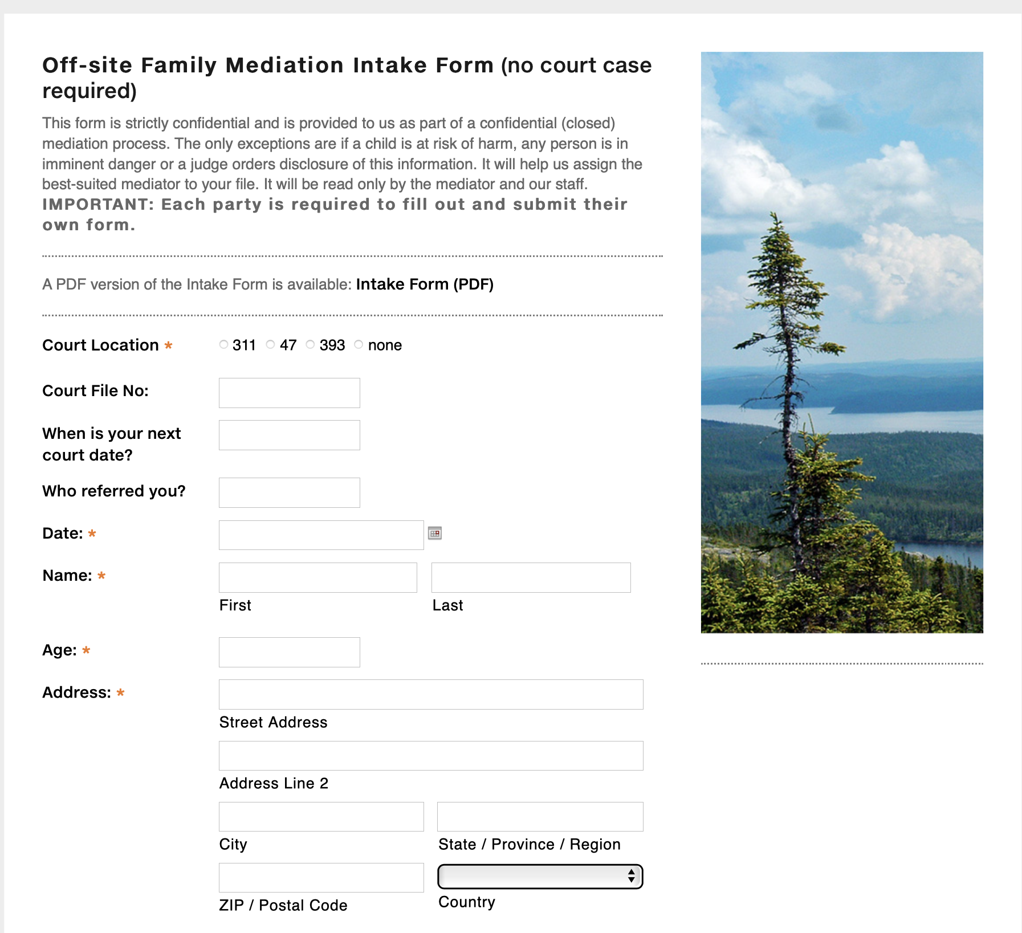
6 HOURS OF SUBSIDIZED MEDIATION WITH FREE INTAKES
Subsidized online mediation is available for anyone whether they have a court case or not, in appropriate cases.
Intake forms are on our website.
We assign the most suitable mediator to each file.
No cost for one hour triage/screening/intake meetings.
Mediators refer clients to other services where mediation is not appropriate.
All issues can be resolved, from parenting to property.

Slide 25
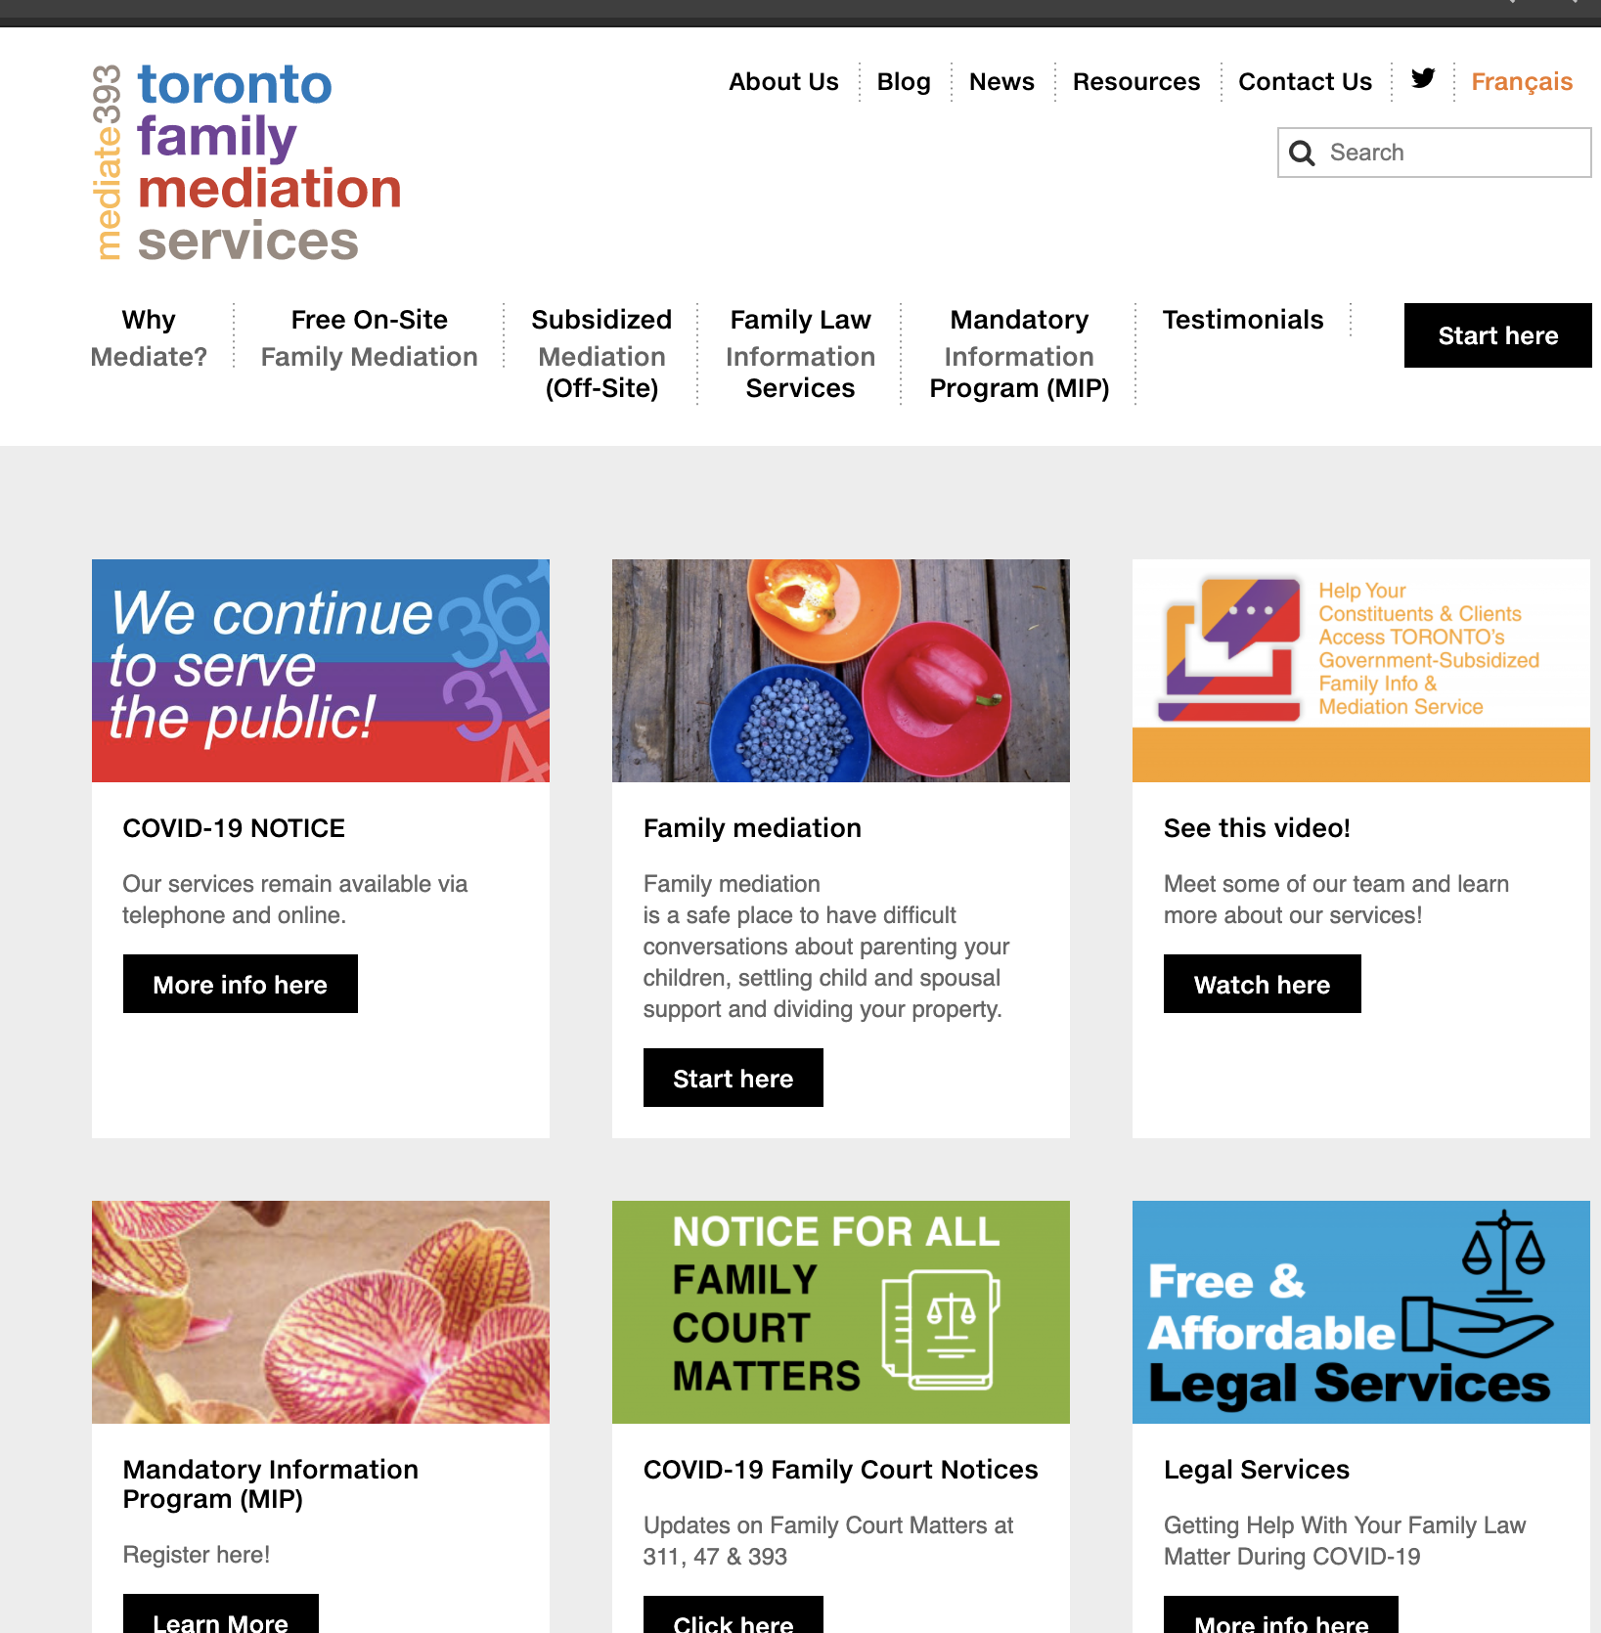
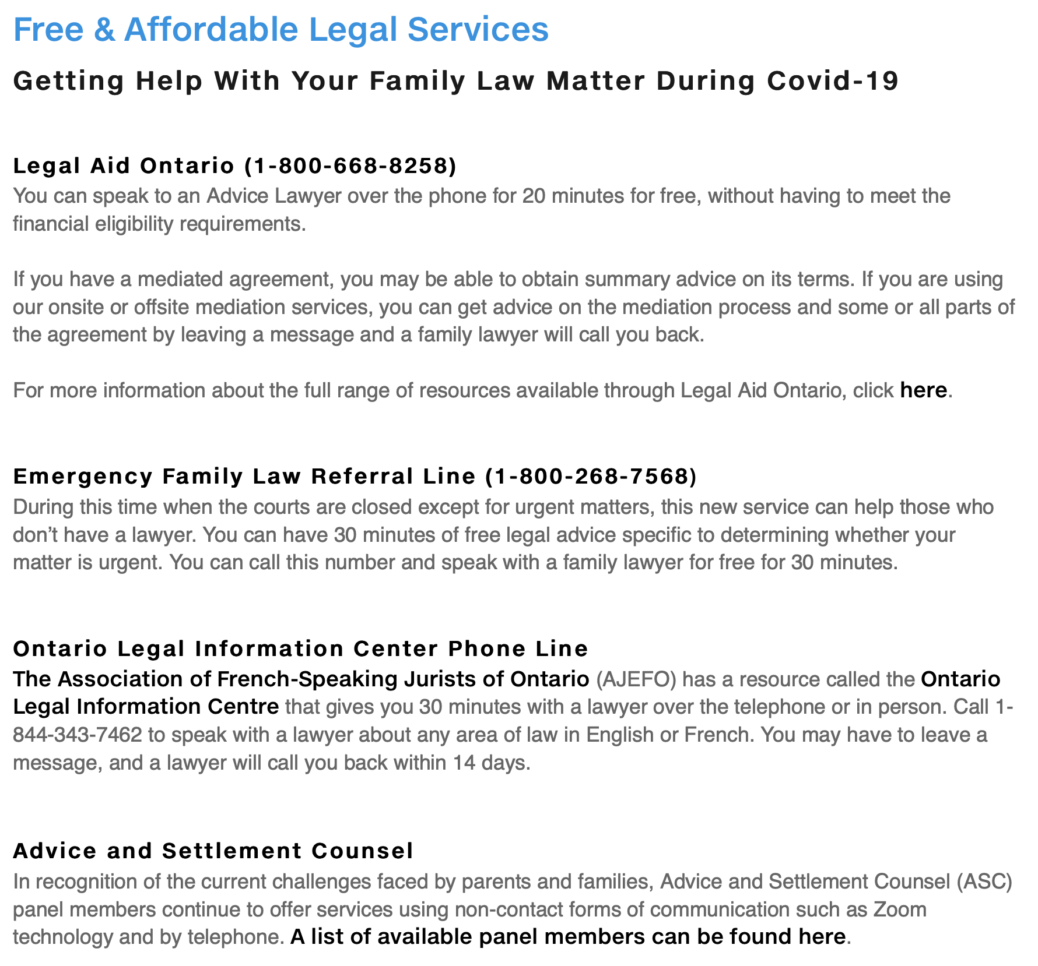

Finding Legal Resources for our Clients

Slide 26
?
Questions

Slide 27


© mediate393
425 University Avenue, Unit 300, Toronto, Ontario M5G 1T6
( 416-593-5393
. info@mediate393.ca
: mediate393.ca

